Slide 1
Main Macroeconomic Data of Georgia
GDP
In 2014 GDP growth rate was 4.6% (Nominal GDP USD 16.5 bln.).
GDP Structure: 17.5% - Trade, 16.9% - Industry, 10.4% - Transport and Communication, 9.9% - Public Administration, 9.3% - Agriculture, forestry and fishing, 7.1% - Construction, 6% - Health care and social work, 22.9% - Other Sectors.
In 2015 the estimated annual growth of real GDP equalled 2.8 percent.
Based on GOG’s forecast, GDP real growth for 2016 is projected at 3%.
FDIs
FDI in 2014 amounted to 1.758 bln.USD (87% increase from 2013).
By origin: EU – 47%, CIS – 26%, other countries – 27%.
By Sectors: Transport and Communication - 25%, Construction-18%, Manufacturing-12%, Energy-11%, Real estate-8%, Financial sector-6%, Other-20%.
FDI in 2015 (preliminary data) amounted to 1,351 Mln. USD (23% decrease compared to 2014).
TRADE TURNOVER
2014 - 11.454 bln. USD, Growth 5%; Change (y-o-y): EU- 4% increase, CIS - 5% decrease.
2015 - trade turnover decreased by 13% compared to 2014 and amounted to 9.928 billion USD. EU – 6% increase (32% of total turnover), CIS – 22% decrease (28% of total turnover)
Export in 2014 - 2.86 bln. USD, Decrease 2%; Change (y-o-y): EU- 2% increase, CIS – 10% decrease.
In 2015 export decreased by 23% compared to 2014 and amounted to 2.204 billion USD. EU – 4% increase (29% of total export), CIS – 43% decrease (38% of total export).
Import in 2014 - 8.6 bln. USD, Growth 7%; Change (y-o-y): EU - 4% increase, CIS – 2% decrease
In 2015 import decreased by 10% compared to 2014 and amounted to 7.724 billion USD. EU - 6% increase (33% of total import), CIS – 7% decrease (25% of total import).

Slide 2
Liberal Trade Regime
Simple and effective tax administration;
Simple and service oriented customs policy;
No quantitative restrictions or other non-tariff barriers;
0% Import tax on up to 90% of Imports;
- Average customs clearance – 15 minutes.
Existing trade regimes with other countries
Free Trade regimes with CIS countries, Turkey and EU – 900 million customer market.
GSP regime with USA, Japan, Norway and Switzerland.
Ongoing negotiations of FTA with EFTA countries and China.

Slide 3
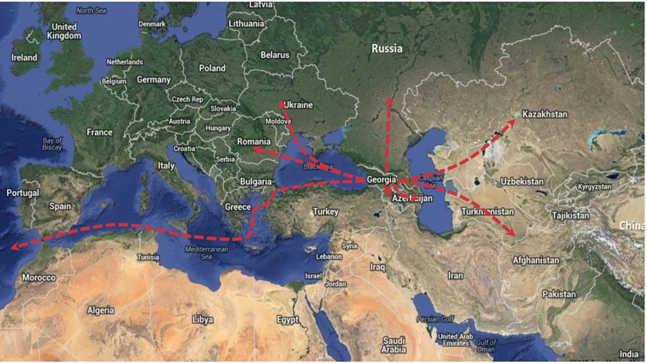
Strategic location

Slide 4
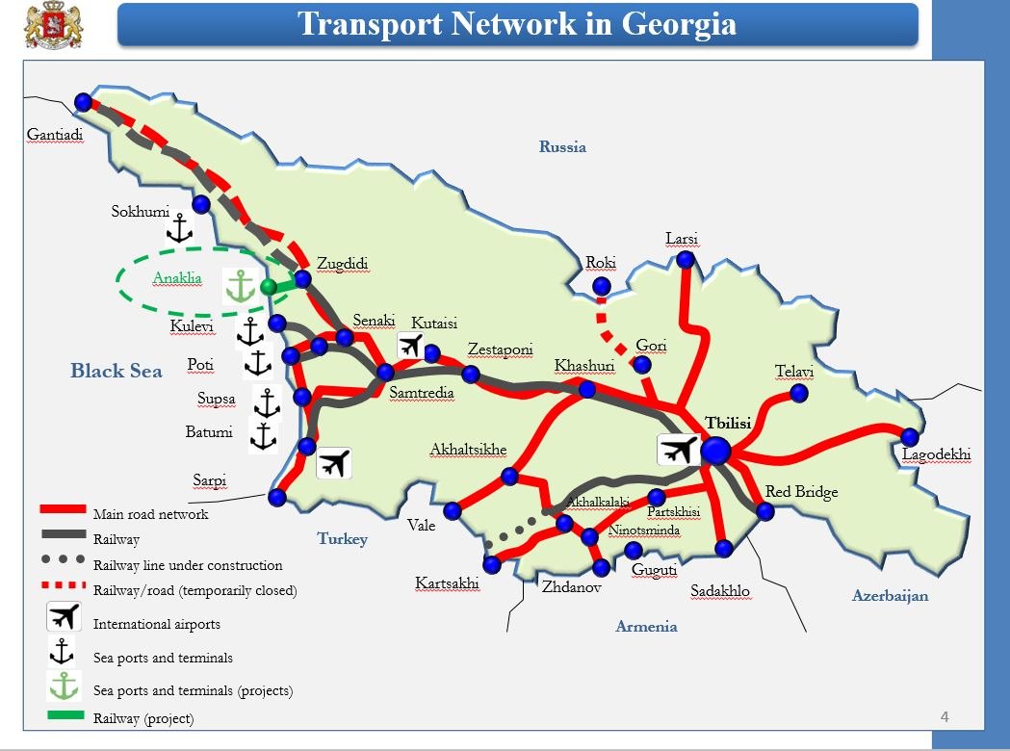

Slide 5
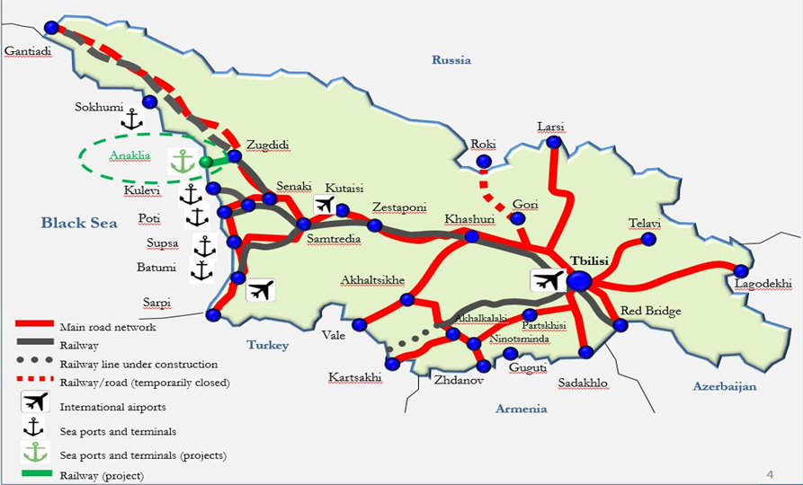
National Infrastructure (Hardware)
Rail Road
- 2 344 km (100% electrifies, except dead-end tracks). 7,400 rolling stock, 144 locos.
- Baku-Tbilisi-Kars Railway, which will be new corridor connecting Azerbaijan, Georgian and Turkish railways
Road Infrastructure
- Modernization of East-West
international highway road with length
1,500 km; After finalization of works,
highway will have four lanes and
capacity to serve 50 000 vehicles per
day.
Port Infrastructure
- Poti Sea Port - capacity - 10 million
tones annually
- Batumi Sea Port - capacity 17 million
tones annually
- Kulevi Terminal - capacity 5 million
tones annually
- Supsa Terminal - capacity 5 million
tones annually
Deep Sea New Port – Anaklia
First deep sea port on Black Sea shore able to receive Panamax and Post-Panamax type of vessels;
Capacity up to 100 mln. tons annually;

Slide 6
International and Regional projects (Software)
To attract more freight to the mentioned corridor and facilitation of smooth movement of goods and passengers through the territories of the Contracting Parties, Government of Georgia participates in several regional and international projects, aiming to reduce tariffs and customs procedures.
The Baku-Tbilisi-Kars railway - will directly connect Turkey, Georgia and Azerbaijan and through the reduction of tariffs and customs procedures will reduce the shipment period from 35 to 15-17 days.
Railroad corridor “Silk railway” - The Transport Consortium is being created for the purpose of transportation of freights from China through Transcaspian corridor towards Turkey and the Europe.
Multi-modal block train (Silk Wind) – aims to develop railway container transportation corridor from China, through Kazakhstan, Azerbaijan, Georgia and Turkey to Europe.
- Transport corridor “Persian Gulf, Iran – Black Sea, European countries” – aims for freight transportation from India through Iran and Azerbaijan toward Georgian Ports (Poti and Batumi) for further transportation to Europe.

Slide 7
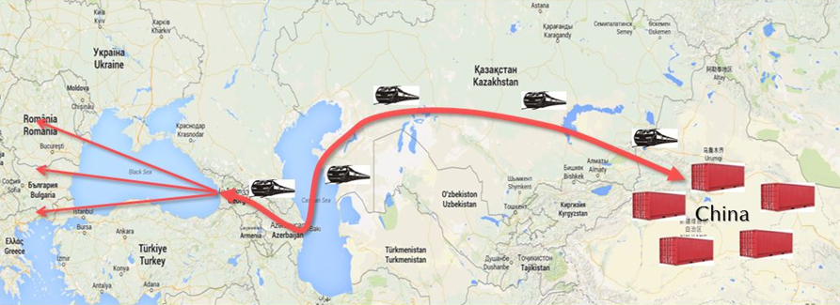
East-West Middle Corridor
Important part of the ancient Silk Road;
Shortest and most efficient root for cargo transportation between Europe and Asia.
9 days are needed for cargo transportation from China to Georgia and 12-14 days from
China to Turkey, through Kazakhstan, Caspian Sea and Azerbaijan;
- In the beginning of 2015 first railway freight transportation from China to Turkey was carried out. Pilot project was implemented with active cooperation of Railways of Georgia, Azerbaijan, Kazakhstan and China – delivery time 9 days;
In February 2015 the first railway freight transportation from China to Turkey was carried out. Pilot project was implemented with close cooperation of Turkey, Georgia, Azerbaijan, Kazakhstan and China – delivery time 12 days;
In January 2015 first freight transportation from Ukraine to China was carried out. Project was implemented with close cooperation of Ukraine, Georgia, Azerbaijan, Kazakhstan and China – delivery time 15 Days

Slide 8
