Slide 1

E-Collaboration of Associations of Retired Professors to Accelerate Cross-Border E-Collaboration of their Members
Report from the Ad Hoc Working Group:
Dr. Al Hermsen, USA (Chair)
Dr. Heinz V. Dreher, Western Australia
Dr. Jože Gricar, Slovenia
Dr. Sandra Patricia Hirst, Canada
Dr. Michelle Porter, Canada
Dr. Nina M. Silverstein, USA
Wednesday, 17th June 2026
Zoom meeting

Slide 2

RPAN - Retired Professors Associations Network
Objectives:
Collaboration
Knowledge sharing
Interlinking between associations
Continued meaningful engagement for retired academics

Slide 3
Background to Today’s Presentation
Ad Hoc Committee met twice since last full network meeting.

Slide 4
Qualitative Methods
Each committee member sent list of (unstructured) topics, ideas, thoughts, … to the designated member who would analyse the material;
Using a process of semantic analysis, the diverse and manifold suggestions coalesced around several themes;
After some back and forth (via email and zoom meeting) we settled on the 7 themes that you will see today;
And now present these as a catalyst for further discussion and idea generation to mature RPAN into an instrument that facilitates the meaningful engagement of retired academics in society.

Slide 5
Theme 1: Institutional Access and Benefits
Presenter: Dr. Heinz V. Dreher
Professor Emeritus. Mahogany Creek, Western Australia
H.Dreher@outlook.com

Slide 6
Institutional Access and Benefits
(TH-01)
Maintaining active status: email, library/database access, IT support
Directory listings, parking/dining discounts, fitness centre access
Emphasis on mutual benefit, not entitlement
Notes:
Here I would like to emphasise mutual benefit – much discussion is couched in terms of privilege, rights, entitlement, and individual benefit of the retiree. It must be a two-way street. So here follows a ‘what & why’ analysis.

Slide 7
Continued Email Access
Preservation of digital artefacts
Ongoing projects beyond retirement
Value of .edu/.ac identity
Institutional benefit: professional link for research follow-up

Slide 8
Why is continued email access important?
As academics we work with information - its management and communication is essential. There will be many e-mail ‘digital artefacts’ that we want preserved into retirement
Ongoing projects past retirement
e-mail accounts with suffix “.edu” or “.ac” or similar – signify educational institution association and may unlock student/faculty plans offered by some software houses, and subscription services
for the institution, it maintains a professional link to the retired academic useful for example in follow-up of published research reports, and many other scenarios

Slide 9
Continued Library and Digital Access
Access to bibliographic databases, repositories, scholarly articles
Knowledge-based work continues post-retirement
Institutional benefit: retirees contribute to research outputs

Slide 10
IT Support and Software Access
Essential for knowledge work
Rapid IT evolution requires support
Institutional benefit: retirees provide diverse user insights
Notes:
What the retiree may want:
IT support, including access to software packages.
Why:
All work requires resources, in our case the knowledge-work requires computers and communication facilities and services. In the IT domain there are frequent and significant advances that underpin efficiency and empowerment. As during our full-time working lives we cannot be ‘experts’ in our knowledge domains and the IT domain, therefore any and every opportunity of support is valued.
and for the institution, all IT users bring their own idiosyncratic perspective, which can inform IT use and provision in a broader sense – as experienced in a ‘learning organisation’. This will augment the standing of the organisation among its stakeholders, peers, and in society (which in many cases funds the organisation).

Slide 11
Concluding Points
Preservation of digital identity into retirement and beyond
Universities differ in policies; respect institutional rules
Importance of documenting good practices and mutual benefits
Essentially, it’s a matter of preserving one’s ‘digital identity, into the future – post-retirement, and for a period after death.

Slide 12
Moving Forward
Universities will continue to have their individual rules about e-mail and information technology use post-retirement and we need to respect that.
There are a variety of approaches taken by universities to the treatment of retirees – some are generous, others perhaps rather illiberal, but we must accept each institution makes rules that fit its purpose.
Nonetheless, it is very useful to document the idiosyncrasies and promulgate good ideas that provide mutual benefit for universities and their retirees. So it can be our task to document reasons for maintaining active e-mail status that benefit the institution in addition to the retiree.
In that spirit we invite ideas, personal experiences, scenarios, and even vignettes.

Slide 13
Theme 2: Research Grants & Funding
Presenter: Dr. Nina M. Silverstein
Professor Emerita, Gerontology Department, University of Massachusetts Boston
Nina.Silverstein@umb.edu

Slide 14
Maintaining ties with the Academy and Profession through Continued Research & Teaching
Legitimize the role of Principal Investigator as an Emeriti
Apply for Research Funding
Continue as a Co-Investigator
Support graduate research assistants through grants
Present at professional conferences
Continue to publish
Explore continued teaching and mentoring opportunities

Slide 15
Theme 3: Academic & Professional Engagement
Presenter: Dr. Michelle Porter
Professor, Faculty of Kinesiology and Recreation Management,
University of Manitoba, Canada, Director of the Centre on Aging.
Co-lead, North American Region for the Age-friendly University Global Network,
Michelle.Porter@UManitoba.ca

Slide 16
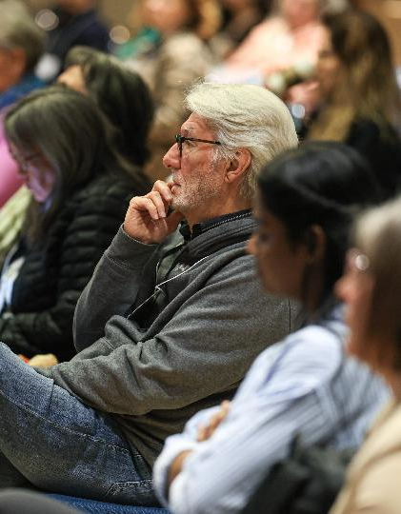
Possible Activities
Academic and Professional Engagement
Opportunities for continued learning
Auditing classes
In-person and online
Other institutional training (e.g., AI)
Ensuring awareness of existing activities
Opportunities to volunteer (e.g., tutoring)
Guest lecturing possibilities
For credit courses
Lifelong learning programs
Peer reviewing or being part of an editorial team
Mentoring new faculty, students and staff
Establishing an "Emeritus College" led by retired faculty

Slide 17
Theme 4: Global Networking & Collaboration
Presenter: Al Hermsen, MBA
Past-President and Member, Board of Directors, University of Michigan Retirees Association, United States,
AHermsen@UMich.edu

Slide 18
Goal
To connect with other higher education institution’s retiree organizations to facilitate collaboration, knowledge sharing, and interlinking between associations so that retired academics can continue meaningful engagement.

Slide 19
What we have done to date:
Established the RPAN website which contains links to other retiree association websites, as well as names and emails of members in those organizations.
Scheduled quarterly meetings with interested parties from the higher education community network
Established a connection with AROHE and CURAC

Slide 20
What other associations are available to connect with:
Osher Lifelong Learning Institute (OLLI)
American Geriatrics Society (AGS)
Geriatric Societies in other countries or states
GSA’s Third Age Interest Group (TAG) (in development)

Slide 21
Establish a “sister city” approach with a sister higher education retiree associations
For example,
the University of Michigan Retiree Association exploring setting up a connection with the University of Windsor Retiree Association.

Slide 22
How do we connect
Share websites – like we are doing on the RPAN website
Make presentations about our associations at the RPAN quarterly meetings
Visit other associations board meetings or membership meetings
Call or email members in other associations
Attend conferences of other associations, like AROHE and CURAC
Encourage more attendance at our quarterly RPAN meetings
An exchange program for people who like to travel

Slide 23
Conferences
Encourage members to attend Retiree Association Conferences in other countries
Should RPAN consider setting up an international conference at some point in the future

Slide 24
Theme 5: Communications & Knowledge Sharing
Presenter: Dr. Jože Gricar
Professor Emeritus, University of Maribor, Slovenia,
Program Coordinator, Inter-Municipality Initiative: Cross-border eCollaboration in the eRegion &
Secretary, Professors Emeriti Network,
Joze.Gricar@UM.si

Slide 25
Retired professors' associations can play a valuable role in preserving expertise, fostering lifelong learning, mentoring younger academics, and maintaining professional networks.
Effective communication and knowledge-sharing strategies often combine traditional and digital approaches.
Communication Channels
Knowledge-Sharing Mechanisms
Collaborative Activities
The roles of Retired Professor Associations Network
Interlinking the website to the websites of partner associations

Slide 26
Communication Channels
1. Regular Meetings
Monthly or quarterly, guest lectures, roundtable discussions, hybrid meetings (in-person and online)
2. Newsletters and Bulletins
Email newsletters with association updates, member achievements, upcoming events, research highlights, book reviews
3. Online Platforms
Dedicated association website, member portal with discussion forums, digital archives of presentations, publications, and recordings, online member directory

Slide 27
Communication Channels
(cont.)
4. Social Media and Messaging
Private groups on platforms such as: WhatsApp, Telegram, LinkedIn, Facebook. Quick dissemination of announcements and opportunities, Informal peer interaction
Thematic webinars featuring retired and active scholars, international participation without travel costs, recorded sessions for later viewing
5. Webinars and Virtual Conferences

Slide 28
Knowledge-Sharing Mechanisms
1. Expert Lecture Series
Public lectures, specialized seminars, interdisciplinary discussions, continuing education courses
2. Mentorship Programs
Pair retired professors with early-career faculty, doctoral students, postdoctoral researchers, academic administrators
Areas of mentoring may include research design, publication strategies, academic leadership, grant writing
3. Knowledge Repositories
Create a digital library containing research papers, lecture notes, teaching materials, memoirs and professional reflections, recorded talks and interviews
4. Communities of Practice
Interest groups organized around: academic disciplines, research methodologies, educational innovation, public policy topics
5. Oral History Projects
Document members' experiences regarding evolution of higher education, scientific discoveries, institutional development, historical academic events

Slide 29
Collaborative Activities
Research Support
Advisory roles in ongoing projects, participation in review panels, co-authorship opportunities, research ethics consultation
Public Engagement
Community lectures, policy discussions, media commentary, educational outreach programs
Intergenerational Exchanges
Joint events with university faculty and students, career-development workshops, research colloquia, alumni engagement activities

Slide 30
Interlinking the website to the websites of partner associations
If the Association of Retired Professors wants to link its website with partner associations' websites, it helps to approach the project from three perspectives:
organizational,
technical, and
content-related.

Slide 31
Example structure
Each entry would link to the partner's website and provide a short description.
For a retired professors' association, a practical first step is to create a well-organized "Partners" page with reciprocal links, then gradually expand to shared news, events, and resources as relationships develop

Slide 32
Theme 6: Community, Health, & Support
Presenter: Dr. Sandra Patricia Hirst
Associate Professor Emerita, Faculty of Nursing, University of Calgary, Canada.
Vice President, College and University Retiree Associations of Canada – CURAC.
E-letter Editor, University of Calgary Retirees Association – UCRA,
shirst@ucalgary.ca

Slide 33
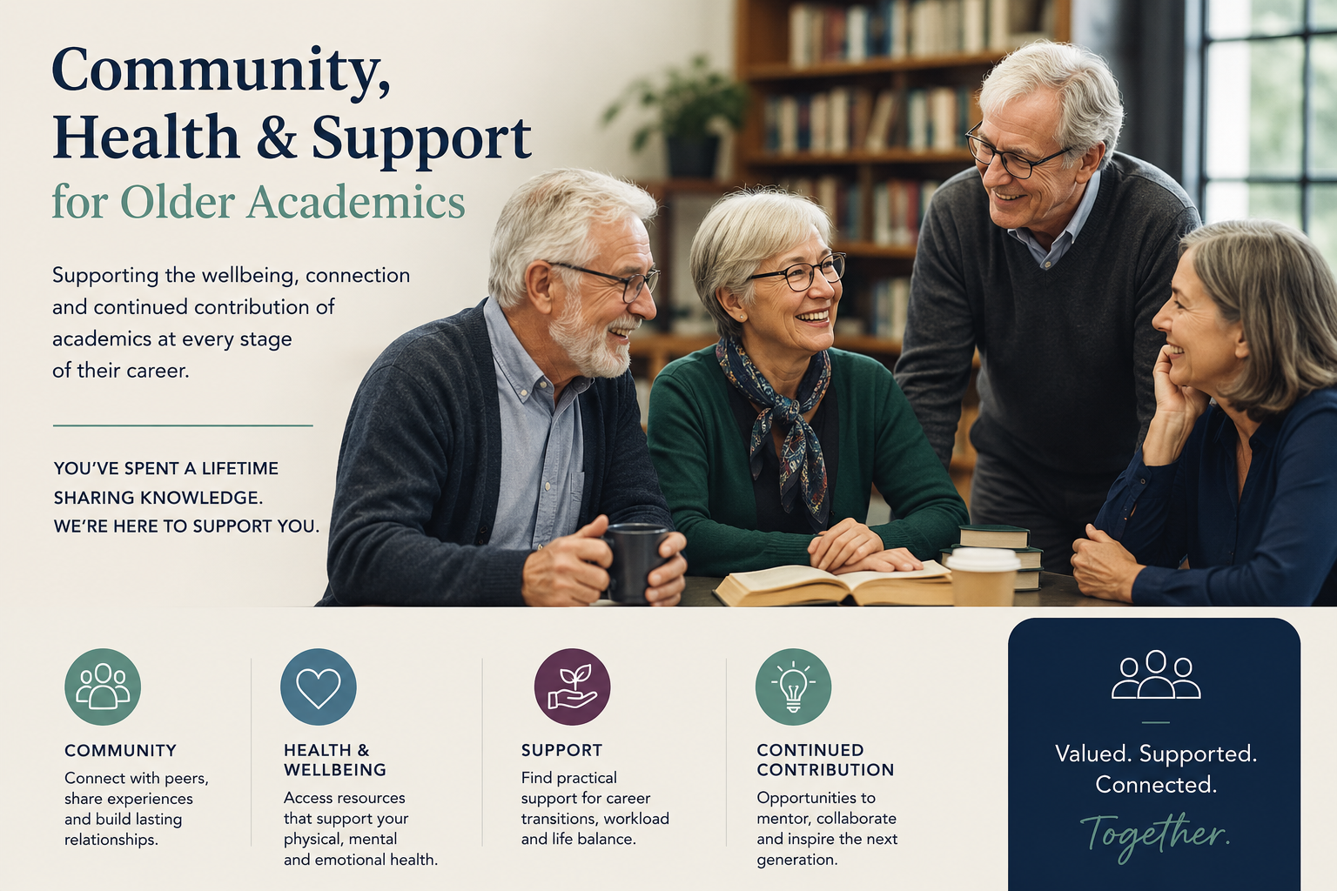
Community, Health & Support

Slide 34
The role of the RPAN
Sharing knowledge of health-related practices via website
Members bring different cultural and regional perspectives on wellbeing, healthcare systems, and lifestyle practices. This can include:
Healthy aging practices
Stress management approaches
Local healthcare insights
Accessibility tools and community resources
This diversity of input can help members make more informed personal decisions

Slide 35

Key activities identified: caregiver support groups, vaccination clinics, volunteer service-learning, and campus wide event notifications.
Example:
IFA - Vaccines 4 Life Program
The Vaccines 4 Life (V4L) Program is a initiative by the International Federation on Ageing (IFA).
dedicated to advancing adult immunization and promoting healthy aging globally.
It operates as a vital knowledge-sharing platform that bridges the gap between science, policy, and patient advocacy.
Link to RPAN network.

Slide 36
Theme 7: Organizational Advocacy & Growth
Open Discussion

Slide 37
Call for Contributions
Invite ideas, experiences, scenarios, vignettes
Focus on function and empowerment, not entitlement
Retirees continue to offer scholarly value
Notes:
at 10am start the “Active Wrting Project” video 13 minutes

Slide 38
A sample vignette:
“…focus on privileges and rights may be distracting us somewhat - really speaking it’s function, and consequential empowerment, from which we will benefit. And we could focus on benefit to the university too. The scholarly articles and research grants that were an important part of our full-time work as professors all contained an email address for subsequent contact and follow-up. Numerous of my overseas research students ‘found’ me and made contact as potential supervisor for their higher degree research projects through these publications. Of course, there is continued consultation of our articles well into the post-retirement era. We have much to offer, let’s also 'talk that up’. ”
Heinz Dreher, personal reflection

Slide 39

Thank you!

