Slide 1



Slide 2
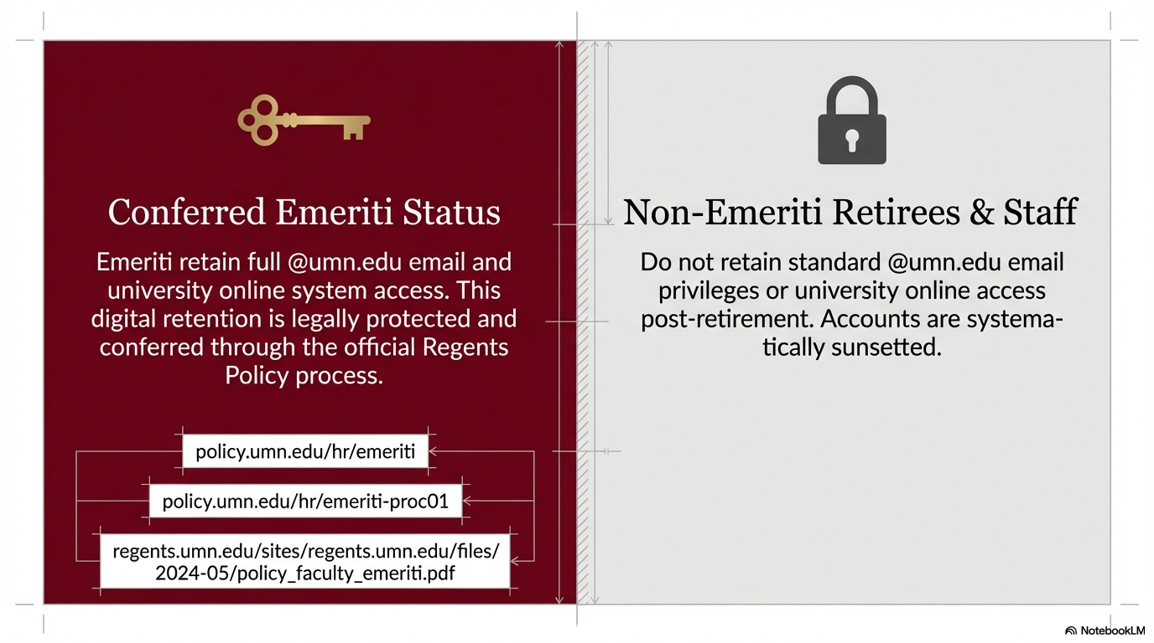

Slide 3
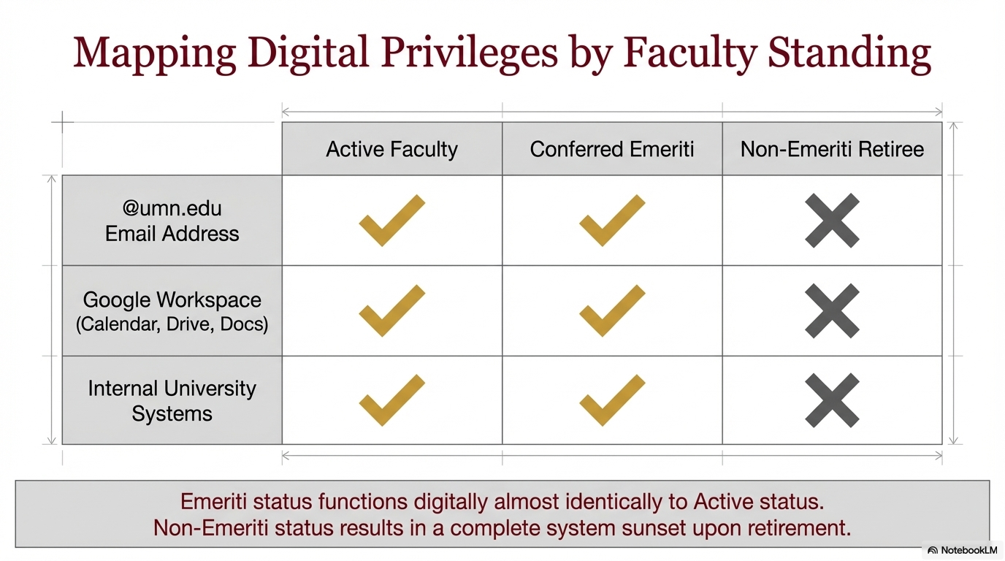

Slide 4


Slide 5


Slide 6
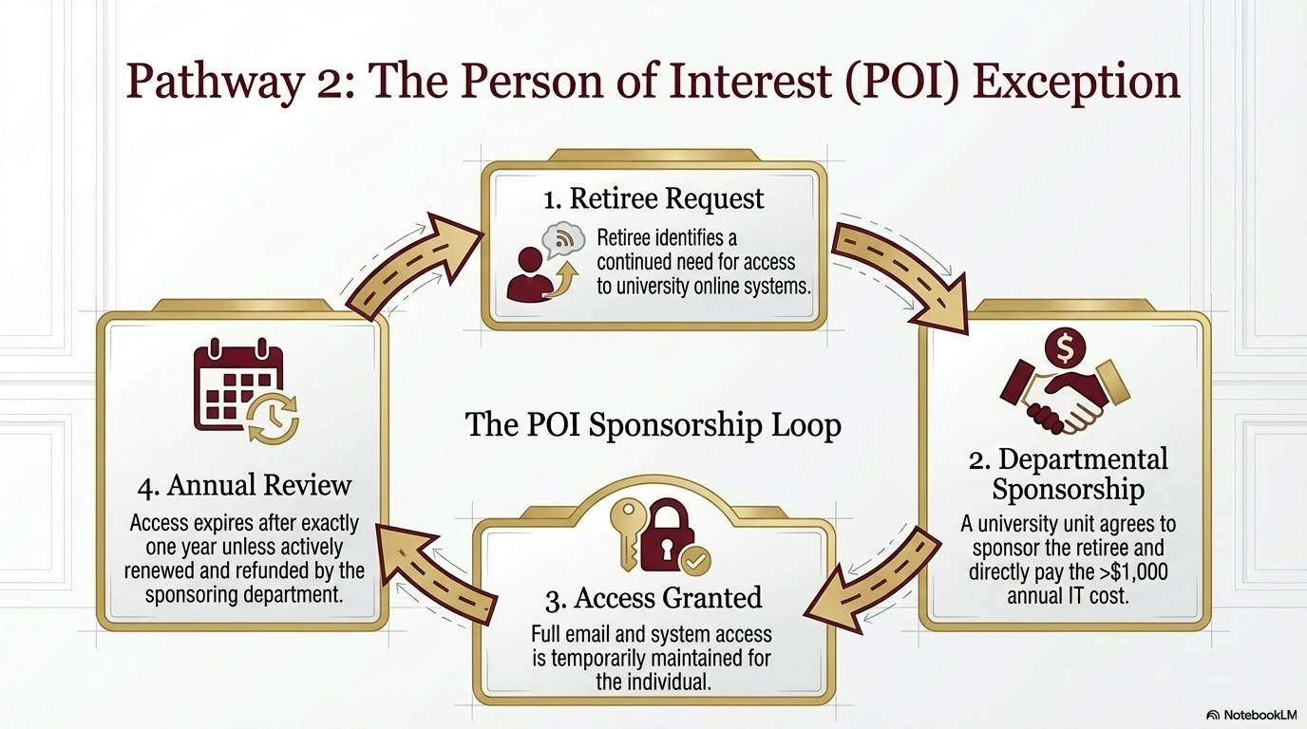

Slide 7
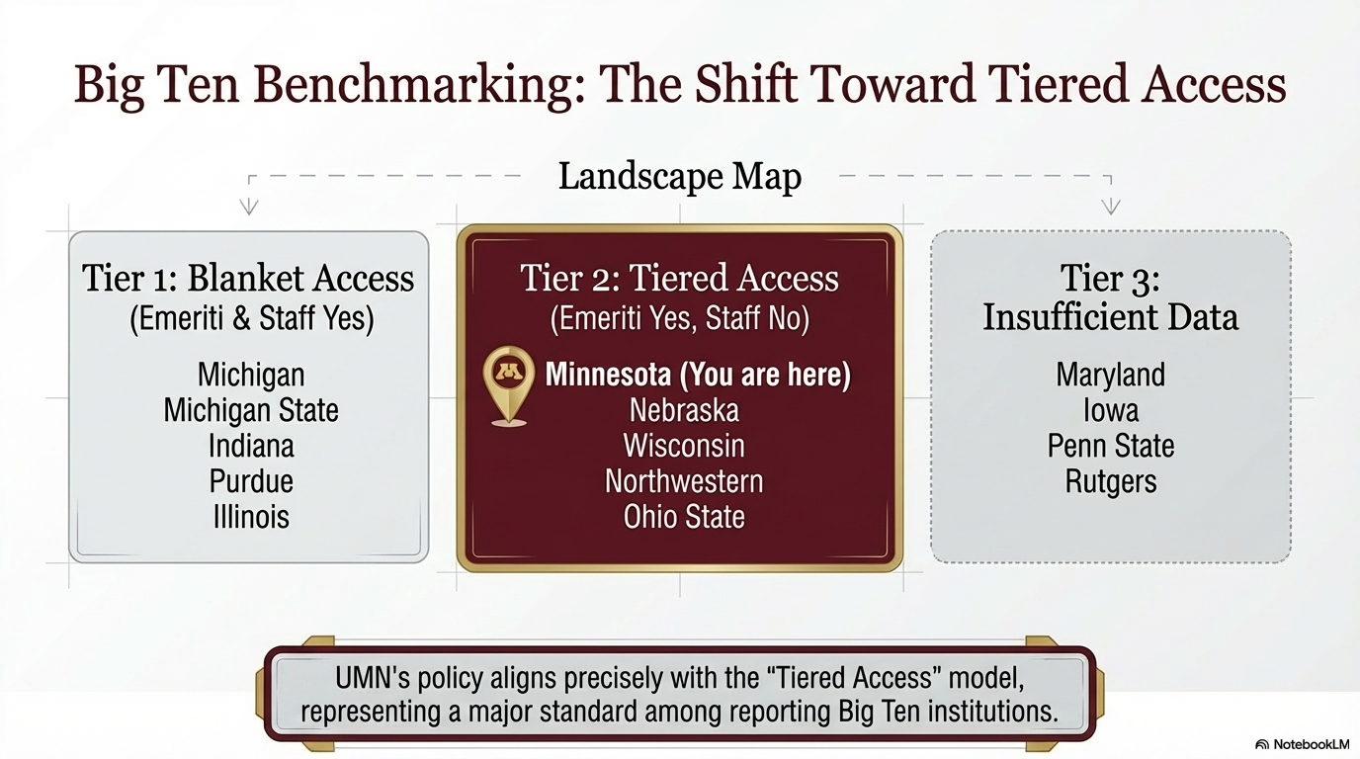

Slide 8
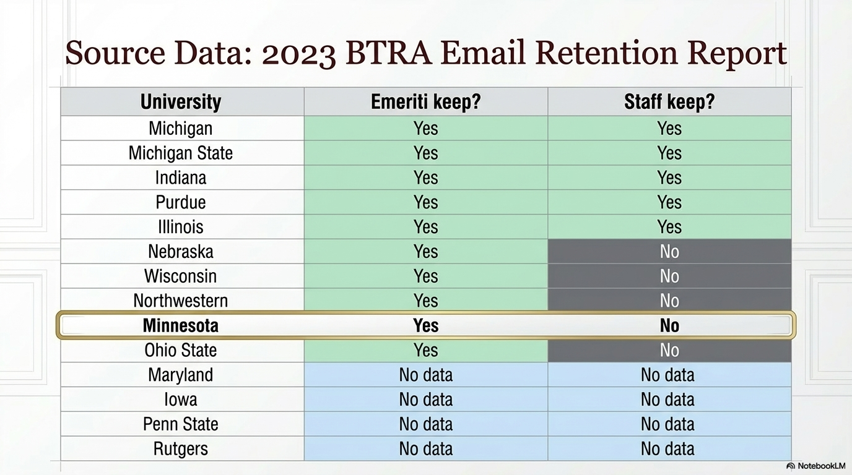

Slide 9
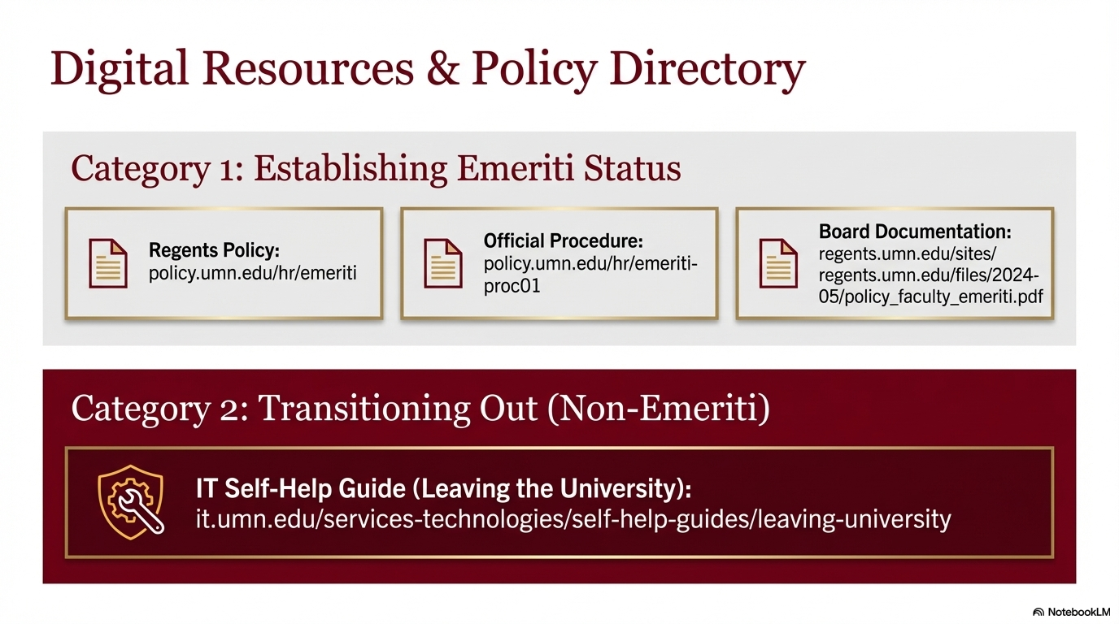

Slide 10
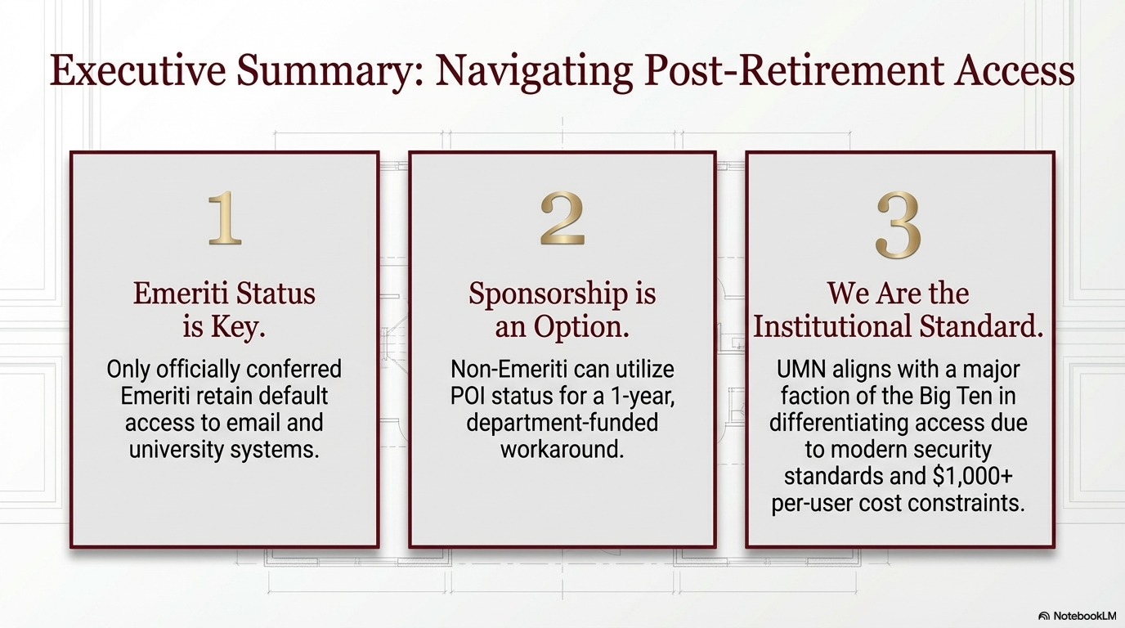

Slide 11


Eric Hockert
President, Association of Retirement Organizations in Higher Education (AROHE.org)
Past-President, University of Minnesota Retirees Association (UMRA.umn.edu)
ehockert@alumni.umn.edu
erichockert@arohe.org

