Slide 1



Linking Retired Academics
Across Nations and Beyond
Preserving Knowledge and Fostering Global Collaboration
Eric Hockert (Minnesota, USA) & Walter Archer (Alberta, Canada)
President AROHE | President CURAC

Slide 2
Our Discussion Today
1. A few creation stories
2. What exists today
3. Key questions, ideas, and proposals
4. Possible directions for us
5. Summary and proposed next steps

Slide 3


"Retirement is not an exit, but a transformation of one's institutional knowledge into a lasting legacy for the next generation of scholars."
Global Academic Network Consensus

Slide 4
Section 1: The Story of Our Roots
How local associations evolved into national and international networks to serve the interests of faculty emeriti.

Slide 5

University of Minnesota (UMRA)
Founding & Growth
Established as a local organization before national federations took shape.
Founding principles centered on institutional memory and retiree welfare.
Current Status: A vibrant community of retired faculty and staff driving local social community, service to the university and beyond, and continued learnings about our world.

Slide 6

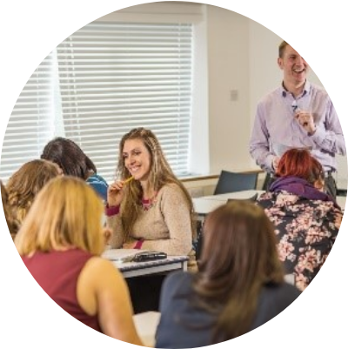
AROHE: A Vision for Higher Ed
Empowering Organizations
Formed to support campus-based retirement organizations through the exchange of successful practices and research.
Transformative practices for all retirement stages.
Enhancing retiree engagement and contributions.

Slide 7


AROHE: The Beginnings
The Association of Retirement Organizations in Higher Education (AROHE) evolved from informal meetings that began in 1984.
Incorporated as a nonprofit in 2002 at the University of Southern California (USC).
The first stop for administrators and retiree organizations seeking to serve retired faculty.
A pioneer in formalizing the "Emeriti" value proposition.

Slide 8






AROHE: Strategic Resources
Philanthropy
Advocacy
Connections
Engaging retirees in giving and donor advocacy for institutions.
Ensuring the voice of retired faculty is heard in higher education policy.
Providing essential links between individuals and university professions.

Slide 9
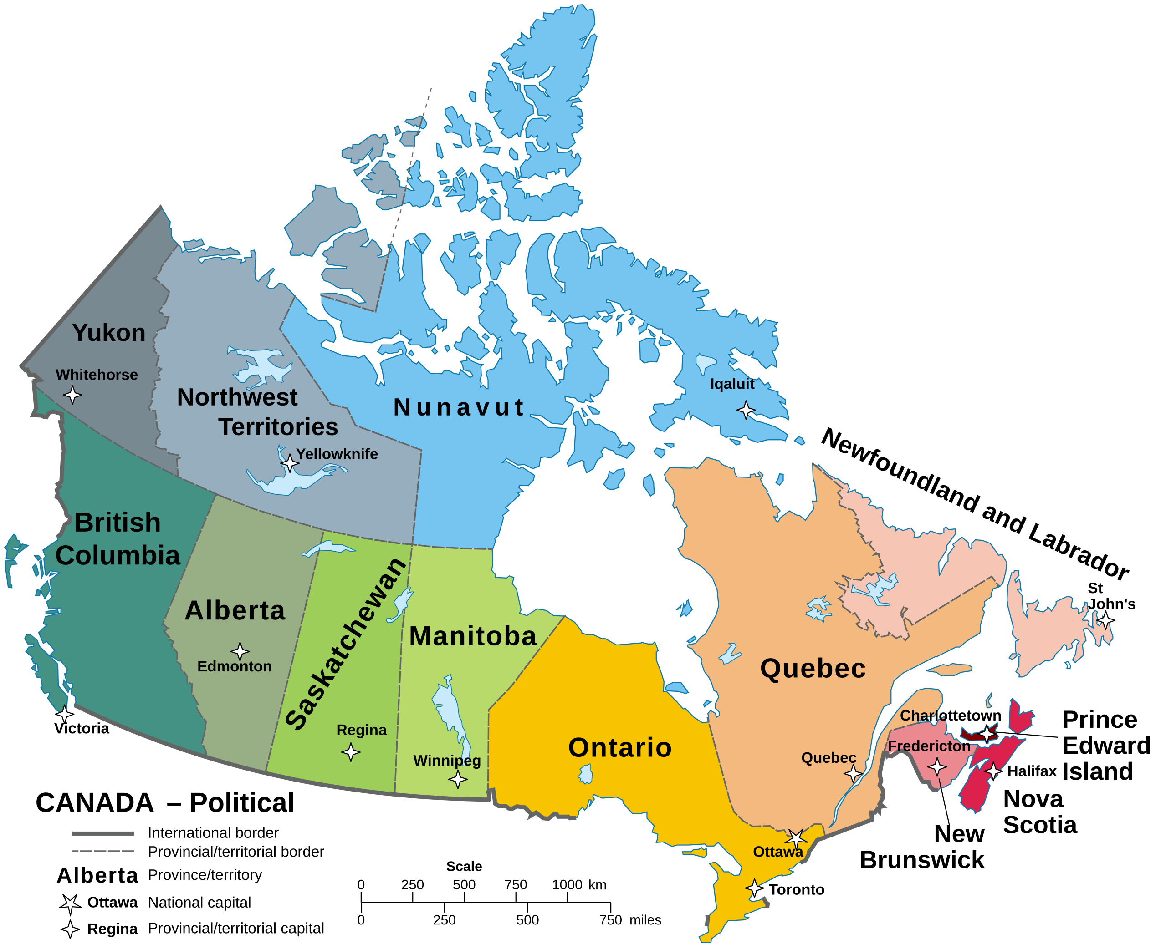
CURAC: The Canadian Landscape
CURAC (College and University Retiree Associations of Canada) serves as a vital non-profit federation across the nation.
Supports and connects retiree organizations of colleges and universities throughout Canada.
Acts as a collective voice that can influence provincial and national governments and private corporations.
Maintains critical links with North American sister organizations.

Slide 10
North American Synergy
Linked
Bridging Borders
CURAC and AROHE are strategically linked to each other. This cross-border collaboration allows for the sharing of research, advocacy strategies, and institutional best practices across the entire North American continent.
Bilateral Partnership

Slide 11
Section 2: What exists today
How local associations evolved into national and international networks to serve the interests of faculty emeriti.

Slide 12


Two Models of Engagement
Emeriti-Only
Faculty & Staff Inclusive
Focuses on maintaining high-level research, scholarly publication, and academic prestige. Often separate from general staff initiatives.
Creates a broad community of all retired university employees. Focuses on institutional loyalty and social connectivity.
Strength: Knowledge preservation and professional continuity.
Strength: Scale, inclusivity, and operational diversity.
Both models serve members through advocacy and benefit negotiation, though their "centers of gravity" differ significantly.

Slide 13
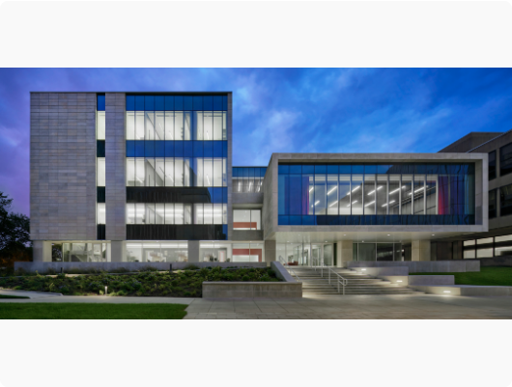
Dedicated Retirement Centers
Berkeley, UCLA, UBC (British Columbia)
Institutionalized centers provide physical and organizational homes for some retirees, bridging the gap between campus and the post-retirement life.
Dedicated staff to coordinate retiree resources.
Robust programming: Lectures, mentoring, and social events.
Maintaining the "University Family" connection.

Slide 14






Existing global networks to inform our discussions
U3A
AFU GN
UNESCO
University of the Third Age provides lifelong learning opportunities for all retirees.
Age-Friendly University Global Network fosters inclusive learning and action.
Potential for high-level global policy integration in education and legacy.

Slide 15

The Professors Emeriti Network Perspective
Professors Emeriti Network
🏠 Represents a potential "home" for faculty emeriti.
Individual-based membership model.
Connected to EU eRegions and Danube Region strategies.
Focus on active aging and intercultural dialogue.

Slide 16

European Association of Professors Emeriti (EAPE): European Connections
Aims to connect retired academics across Europe to foster continued scientific contribution, mentorship, and interdisciplinary collaboration.
EAPE fosters a continent-wide network that allows retired professors to maintain their scientific activity and contribute to European higher education through mentorship and policy influence.

Slide 17




Strategic Goals
Institutional Value
Legacy Management
Global Dialogue
Increasing retirees' value to their colleges and universities.
Preserving institutional knowledge for future faculty generations.
Fostering intercultural exchange between academic networks.

Slide 18
Strategic Missions & Areas of Impact
Philanthropic Engagement: Creating structured avenues for retirees to contribute to institutional development.
Resource Center: Serving as the "first stop" for administrators to engage retired faculty.
Advocacy & Policy: Standing on behalf of retirees in community and professional sectors.
Digital Networking: Utilizing web resources such as LinkedIn and others to maintain lifelong professional connections.

Slide 19
The AROHE Virtual Chapter (VRC)
A New Digital Home for Individuals
1,000
The VRC is designed to serve as a worldwide organization for individual retirees (faculty and staff) who lack a local campus-based association.
Key Target: Scale to 4,000 members within 5 years at an affordable $20 USD annual fee.
MEMBER GOAL FOR YEAR 1
https://www.arohe.org/Virtual-Retirement-Chapter

Slide 20

Global Cooperation
An Example

Slide 21
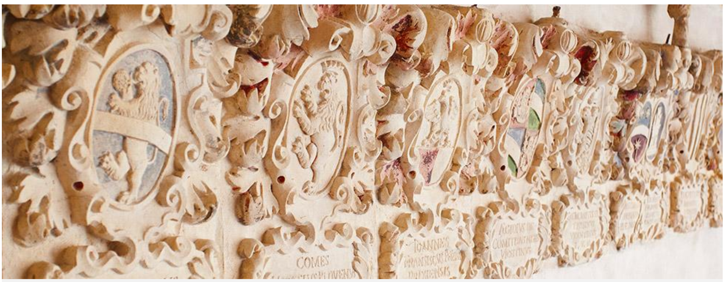

Initiatives of the commission for ethics in research of PLE (Patavinae Libertatis Emeriti)
Bernhard A. Schrefler

Slide 22
Scientific misconduct is a big problem worldwide. In Italy we try to address this through the emeriti and need your help and input. A global cooperation would be a benefit to all.

Slide 23
Scientific Misconduct: A Growing Concern
Acts against research ethics have increased markedly in recent years.
Key Contributing Factors
Intensified pressure to publish (“publish or perish”)
Evaluation systems for career advancement and research funding that prioritize quantity over quality
Consequences
Rising number of publications containing plagiarized, falsified, or fabricated data
Severe distortion of:
  Scientific credibility
  Public health decision-making
  Training and career development of young scientists
  Societal progress as a whole
Illustrative Cases
Room-temperature superconductors (Nature, 2020)
Alleged safety of glyphosate (Regulatory Toxicology and Pharmacology, 2000)
Claimed association between vaccines and autism (The Lancet, 1999)

Slide 24
Paper mills
Review mills
Citation Rings
Data fabrication
Data falsification
Plagiarism
Multiple publications or self-plagiarism

Slide 25
Scientific misconduct
is effectively considered a form of fraud, as it involves the manipulation, falsification, or fabrication of data, or plagiarism, for the purpose of gaining profit (academic or financial) by misleading the scientific community. These actions corrupt the research process, often leading to the retraction of scientific articles by journals
Retraction: author(s), whistleblower or sleuths; editor; Integrity Assurance and Case resolution team (Publisher)
“Retraction is science’s dead penalty for a paper” J. Brainard, Science, 25 Oct. 2018
PubPeer https://pubpeer.com/publications
Retraction watch https://retractionwatch.com/

Slide 26
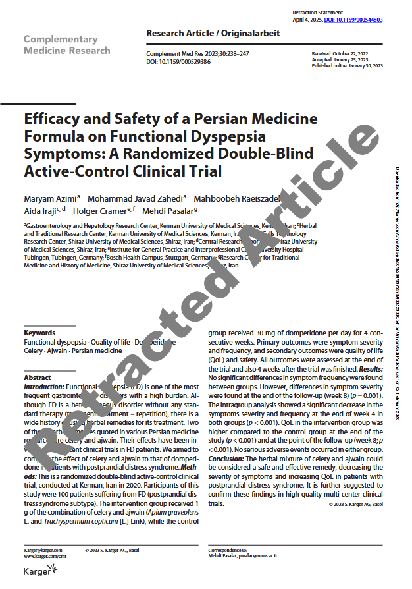
A retracted paper does not disappear, it remains in the Journal's collection
Numbers
0.04% of published papers are retracted
40% are "honest errors," the remainder related to fraud, multiple publications, and plagiarism
2% of scientists are responsible for 25% of all retractions (repeat offenders)
(Ritchie, 2021)

Slide 27
Universities
The Academy and Italian scientific institutions respond to all this by issuing extensive and detailed regulations to protect the integrity of research; however, unlike in other European countries or in the Anglo-Saxon context, these regulations seem to have only rarely led to truly incisive corrective initiatives.

Slide 28
Non-profit funding bodies
(bank foundations, etc.)
They begin to ask themselves why they should fund individuals who have been justifiably sanctioned by external bodies—journals, in this case—and who, as such, have violated the code of scientific ethics, caused harm to science, and set a damaging example for young researchers.

Slide 29
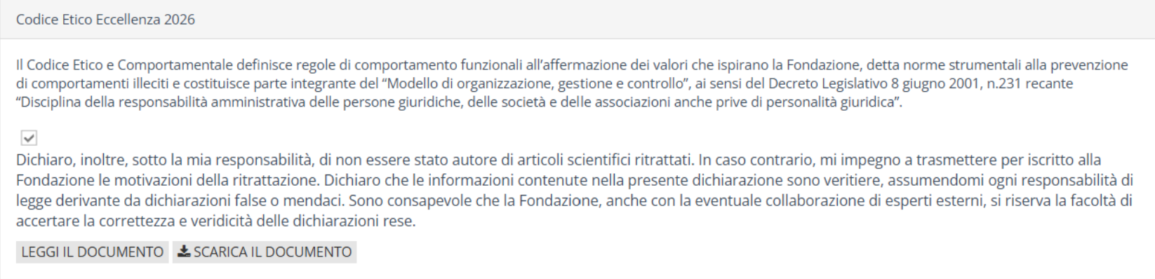
A first example in Italy: the CA.RI.PA.RO. Foundation (for projects of excellence)
The Foundation's maximum contribution is €400,000 for projects in the Natural Sciences and Engineering (PE) and Life Sciences (LS) areas; €200,000 for projects in the Human and Social Sciences (SH) area.
(screen shot, Fondazione CA.RI.PA.RO, 2026)
“I further declare, under my own responsibility, that I am not the author of any retracted scientific articles. Should this not be the case, I undertake to submit to the Foundation, in writing, the reasons for the retraction. I declare that the information contained in this statement is true and accurate, and I assume all legal responsibility arising from any false or misleading declarations. I am aware that the Foundation, including with the possible assistance of external experts, reserves the right to verify the accuracy and truthfulness of the statements made.”

Slide 30
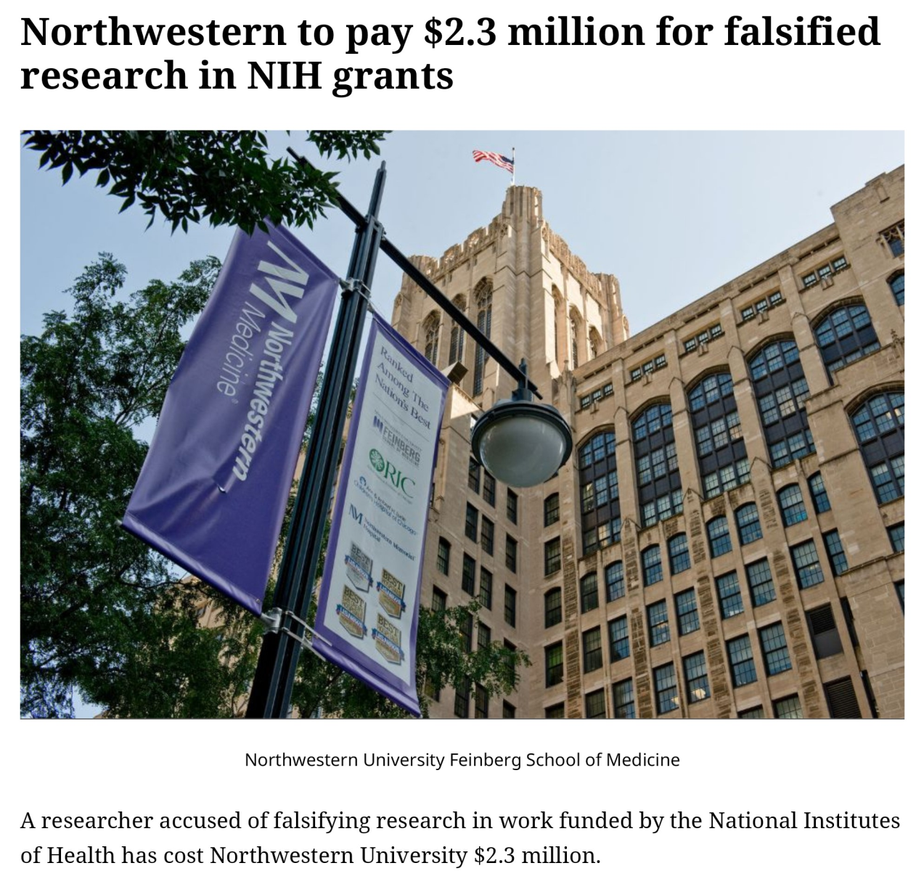
Those who defraud science also create potential material damage to the university
(Retraction watch, 2026)

Slide 31
We propose that the following be included in the code of ethics of the University of Padua as a precautionary measure
It shall be considered INAPPROPRIATE for a faculty member or researcher who is the author or co-author of one or more retracted publications—on the basis of the journal’s own investigation and assessment—and who is unable to demonstrate complete lack of involvement in the reasons that led to the retraction, to:
hold elective or appointed academic positions (Rector, Vice-Rector, Delegate, Head of Department, PhD Program Coordinator, Dean/President of a School, Chair of a Degree Program, Director of a School of Specialization);
participate as a candidate in competitions for career advancement;
participate in selection procedures as a member of the examining committee.
P. Blandina, P. Geppetti, A. Mugelli, Unifi

Slide 32
An example where benefits that can be obtained from communication among academics in different countries: we need information on how this problem is tackled elsewhere and support
Thank you

Slide 33
Section 3: Possible Directions for Us

Slide 34




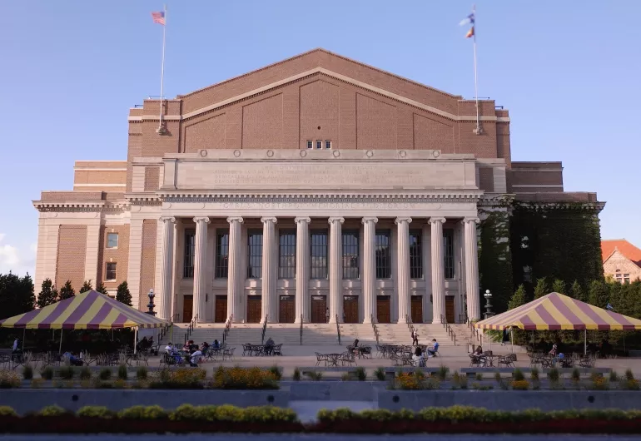


What is the Next Step?
Build the Retired Professors Associations Network
Individual Home
Hybrid Route
Strengthen links between existing associations (Federation model).
Pivot toward individual membership models like EAPE or VRC.
Collaborate across CURAC, AROHE, and European networks.

Slide 35
Or
Wait for the situation to evolve

Slide 36
Section 4: Questions, ideas, proposals
What do we want to accomplish with this linking of groups of retired academics across nations and beyond?
What is the relationship among some of the key groups
  Professors Emeriti Network
EAPE
AROHE
CURAC
Retired Professors Associations Network (https://eregion.eu/retired-professors-associations-network/)
Other organizations – UNESCO, AFU GN, University of the Third Age
Individuals (faculty and staff)
Notes:
https://eregion.eu/retired-professors-associations-network/

Slide 37
Questions (continued)
Does this Network intend to carry out other activities in addition to sharing website links
What are potential points of conflict
Are all these groups trying to do the same thing with the same categories of retirees
Do we want to be a global group
How can we complement and support each other
What else is important for us to understand at this point

Slide 38

Section 5: Summary and next steps
What do we want to accomplish together?
Proposed Next Step:
Form a small global action group (3-5 people)
Review today’s discussion
Formulate a path forward including purpose and organizational structure
Walter Archer: warcher@ualberta.ca
Eric Hockert: ehockert@alumni.umn.edu

Slide 39
Discussion
Let's discuss the path forward for our retiree networks.
https://eregion.eu/professors-emeriti-network-2025/
www.arohe.org | www.curac.ca | www.eape.org
https://eregion.eu/retired-professors-associations-network
/

