Slide 1



Linking Retired Academics
Across Nations and Beyond
Preserving Knowledge and Fostering Global Collaboration
Eric Hockert (Minnesota, USA) & Walter Archer (Alberta, Canada)
President-elect AROHE | President CURAC

Slide 2
Our Discussion Today
1. A few creation stories
2. What exists today
3. Key questions, ideas, and proposals
4. Possible directions for us
5. Summary and proposed next steps

Slide 3


"Retirement is not an exit, but a transformation of one's institutional knowledge into a lasting legacy for the next generation of scholars."
Global Academic Network Consensus

Slide 4
Section 1: The Story of Our Roots
How local associations evolved into national and international networks to serve the interests of faculty emeriti.

Slide 5

University of Minnesota (UMRA)
Founding & Growth
Established as a local organization before national federations took shape.
Founding principles centered on institutional memory and retiree welfare.
Current Status: A vibrant community of retired faculty and staff driving local social community, service to the university and beyond, and continued learnings about our world.

Slide 6

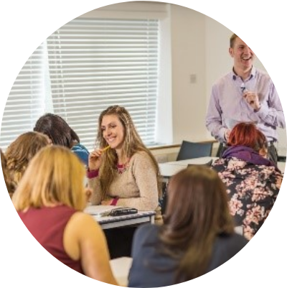
AROHE: A Vision for Higher Ed
Empowering Organizations
Formed to support campus-based retirement organizations through the exchange of successful practices and research.
Transformative practices for all retirement stages.
Enhancing retiree engagement and contributions.

Slide 7


AROHE: The Beginnings
The Association of Retirement Organizations in Higher Education (AROHE) evolved from informal meetings that began in 1984.
Incorporated as a nonprofit in 2002 at the University of Southern California (USC).
The first stop for administrators and retiree organizations seeking to serve retired faculty.
A pioneer in formalizing the "Emeriti" value proposition.

Slide 8






AROHE: Strategic Resources
Philanthropy
Advocacy
Connections
Engaging retirees in giving and donor advocacy for institutions.
Ensuring the voice of retired faculty is heard in higher education policy.
Providing essential links between individuals and university professions.

Slide 9
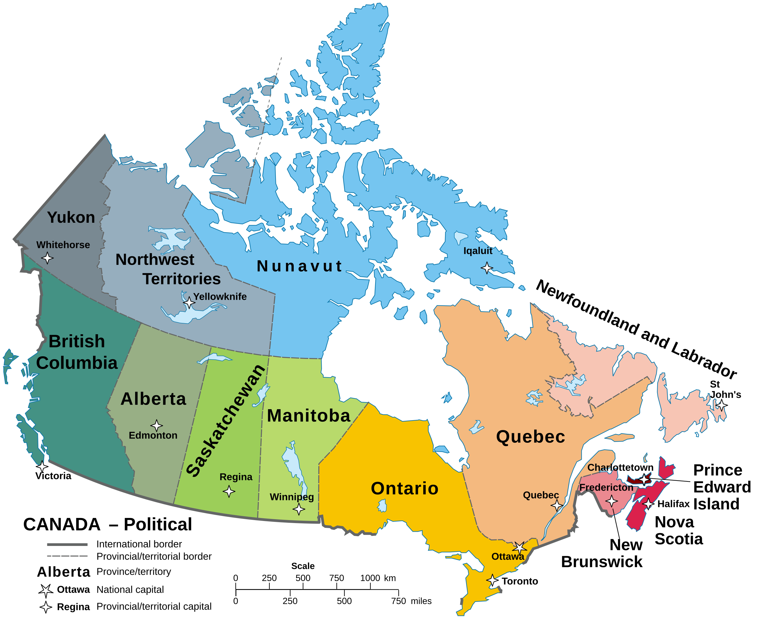
CURAC: The Canadian Landscape
CURAC (College and University Retiree Associations of Canada) serves as a vital non-profit federation across the nation.
Supports and connects retiree organizations of colleges and universities throughout Canada.
Acts as a collective voice that can influence provincial and national governments and private corporations.
Maintains critical links with North American sister organizations.

Slide 10
North American Synergy
Linked
Bridging Borders
CURAC and AROHE are strategically linked to each other. This cross-border collaboration allows for the sharing of research, advocacy strategies, and institutional best practices across the entire North American continent.
Bilateral Partnership

Slide 11
Section 2: What exists today
How local associations evolved into national and international networks to serve the interests of faculty emeriti.

Slide 12


Two Models of Engagement
Emeriti-Only
Faculty & Staff Inclusive
Focuses on maintaining high-level research, scholarly publication, and academic prestige. Often separate from general staff initiatives.
Creates a broad community of all retired university employees. Focuses on institutional loyalty and social connectivity.
Strength: Knowledge preservation and professional continuity.
Strength: Scale, inclusivity, and operational diversity.
Both models serve members through advocacy and benefit negotiation, though their "centers of gravity" differ significantly.

Slide 13
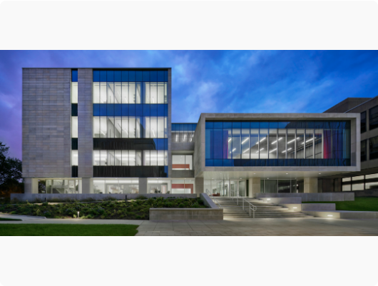
Dedicated Retirement Centers
Berkeley, UCLA, UBC (British Columbia)
Institutionalized centers provide physical and organizational homes for some retirees, bridging the gap between campus and the post-retirement life.
Dedicated staff to coordinate retiree resources.
Robust programming: Lectures, mentoring, and social events.
Maintaining the "University Family" connection.

Slide 14






Existing global networks to inform our discussions
U3A
AFU GN
UNESCO
University of the Third Age provides lifelong learning opportunities for all retirees.
Age-Friendly University Global Network fosters inclusive learning and action.
Potential for high-level global policy integration in education and legacy.

Slide 15

The Professors Emeriti Network Perspective
Professors Emeriti Network
🏠 Represents a potential "home" for faculty emeriti.
Individual-based membership model.
Connected to EU eRegions and Danube Region strategies.
Focus on active aging and intercultural dialogue.

Slide 16

European Association of Professors Emeriti (EAPE): European Connections
Aims to connect retired academics across Europe to foster continued scientific contribution, mentorship, and interdisciplinary collaboration.
EAPE fosters a continent-wide network that allows retired professors to maintain their scientific activity and contribute to European higher education through mentorship and policy influence.

Slide 17




Strategic Goals
Institutional Value
Legacy Management
Global Dialogue
Increasing retirees' value to their colleges and universities.
Preserving institutional knowledge for future faculty generations.
Fostering intercultural exchange between academic networks.

Slide 18
Strategic Missions & Areas of Impact
Philanthropic Engagement: Creating structured avenues for retirees to contribute to institutional development.
Resource Center: Serving as the "first stop" for administrators to engage retired faculty.
Advocacy & Policy: Standing on behalf of retirees in community and professional sectors.
Digital Networking: Utilizing web resources such as LinkedIn and others to maintain lifelong professional connections.

Slide 19
The AROHE Virtual Chapter (VRC)
A New Digital Home for Individuals
1,000
The VRC is designed to serve as a worldwide organization for individual retirees (faculty and staff) who lack a local campus-based association.
Key Target: Scale to 4,000 members within 5 years at an affordable $20 USD annual fee.
MEMBER GOAL FOR YEAR 1
https://www.arohe.org/Virtual-Retirement-Chapter

Slide 20
Section 3: Possible Directions for Us

Slide 21




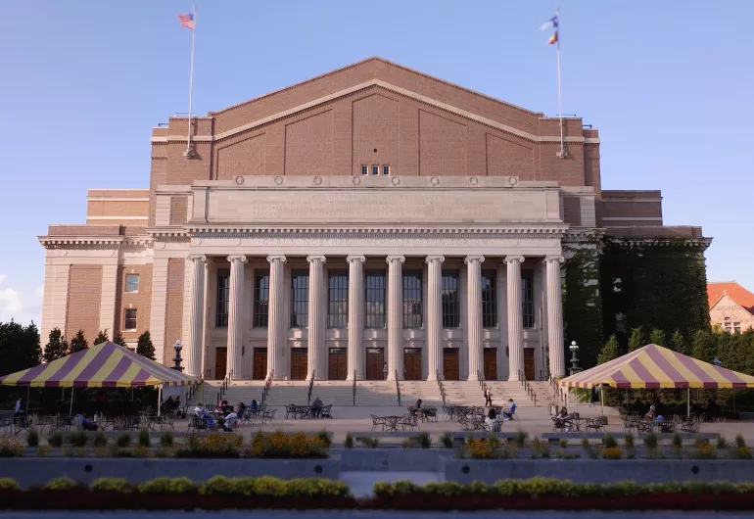


What is the Next Step?
Build the Retired Professors Associations Network
Individual Home
Hybrid Route
Strengthen links between existing associations (Federation model).
Pivot toward individual membership models like EAPE or VRC.
Collaborate across CURAC, AROHE, and European networks.

Slide 22
Or
Wait for the situation to evolve

Slide 23
Section 4: Questions, ideas, proposals
What do we want to accomplish with this linking of groups of retired academics across nations and beyond?
What is the relationship among some of the key groups
  Professors Emeriti Network
EAPE
AROHE
CURAC
Retired Professors Associations Network (https://eregion.eu/retired-professors-associations-network/)
Other organizations – UNESCO, AFU GN, University of the Third Age
Individuals (faculty and staff)
Notes:
https://eregion.eu/retired-professors-associations-network/

Slide 24
Questions (continued)
Does this Network intend to carry out other activities in addition to sharing website links
What are potential points of conflict
Are all these groups trying to do the same thing with the same categories of retirees
Do we want to be a global group
How can we complement and support each other
What else is important for us to understand at this point

Slide 25

Section 5: Summary and next steps
What do we want to accomplish together?
Proposed Next Step:
Form a small global action group (3-5 people)
Review today’s discussion
Formulate a path forward including purpose and organizational structure
Walter Archer: warcher@ualberta.ca
Eric Hockert: ehockert@alumni.umn.edu

Slide 26
Discussion
Let's discuss the path forward for our retiree networks.
https://eregion.eu/professors-emeriti-network-2025/
www.arohe.org | www.curac.ca | www.eape.org
https://eregion.eu/retired-professors-associations-network
/

