Slide 1

Professors Emeriti Network
Eric Hockert
President-elect
(President term 2027-2028)
AROHE.org

Slide 2

We believe
Higher education retirees are valuable assets to society, who reinvent, not retire from, life; positively impact their communities; and contribute to the greater good.

Slide 3

What is AROHE?
  support campus retirement organizations (ROs) and
  expand and enhance the services they offer to their members.
Notes:
Talking points: AROHE champions transformative practices to support all stages of faculty and staff retirement, the mutually beneficial engagement of retirees with one another and with their institutions, and their continuing contributions to campus and community life.
AROHE champions transformative practices that support faculty and staff throughout all stages of retirement—from planning to post-retirement engagement.
We promote mutually beneficial engagement between retirees, their institutions, and the broader community—ensuring that retirees continue to contribute meaningfully to academic and civic life.
AROHE works to support and strengthen campus retirement organizations (ROs) by offering resources, best practices, and professional development opportunities.
We expand and enhance the services ROs provide, helping them create inclusive, relevant, and engaging programs for their members.
Through national and international collaboration, we serve as a hub for innovation and community-building in higher education retirement.
We believe that retirement is not an end—but a new chapter of possibility, purpose, and connection.

Slide 4
By the numbers
2,000+ U.S. higher ed institutions without retiree organizations
Pre-retirement professionals (55-65): 684,813 individuals
Current retirees (65+): 456,542 individuals

Slide 5
Our Community Footprint
108 Retiree Organizations across the U.S. and Canada with over 74,000 retirees actively engaged through AROHE’s member network
Virtual Retirement Chapter (VRC) with pre-retirees and retirees from organizations without a retirement chapter

Slide 6

Supporting the Management of Retirement Organizations in the United States and Canada
Member Resource Center
  Briefs – short “how-to” documents
  Member Shared Resources
Large Scale Events based on our collective strength
  Reimagining Retirement Series
    1,000+ registered
  2026 In-Person Conference
    100+ attendees expected
Convening
  Idea Exchanges and Discussion Forum
  Presidents Council (coming soon)
Notes:
Talking Points:
AROHE Briefs focused on Types and Benefits of Retirement Organizations and Retirement Organization Management and Programs
Member Shared Resources like communications & marketing, surveys & reporting, and organizational management
AROHE provides essential tools and knowledge to help retirement organizations (ROs) thrive and adapt to changing retiree needs.
Our Member Resource Center is a hub for guides, templates, and examples that streamline RO operations.
AROHE Briefs offer deep dives into the types, benefits, and management strategies of retirement organizations—helping members implement best practices.
Members share valuable tools in areas like communications and marketing, surveys and assessment, and organizational management, fostering peer learning and collaboration.
We leverage our collective strength through large-scale events like the Reimagining Retirement Series and the upcoming 2026 In-Person Conference, offering professional development and strategic insight.
AROHE fosters a culture of convening and connection through Idea Exchanges, discussion forums, and coming soon, a Presidents Council to promote leadership-level engagement.

Slide 7

Expanding Services to Retirees
Virtual Events
  Reimagining Retirement Series
  Topic Specific Education i.e. Estate Planning Series
Travel Opportunities
  Five trip opportunities a year
  Trips designed for higher education professionals in mind
Online Resources
  AROHE Briefs focused on transitioning to retirement
  AROHE Online Bookstore: Making books of interest to retirees easily accessible
Notes:
AROHE Talking Points: Expanding Services to Retirees Through Campus Retirement Organizations
AROHE helps retirement organizations enhance the value they provide to their members by offering a wide range of engaging programs and resources.
We host virtual events that bring together retirees from across the country to learn, connect, and share ideas—no matter where they live.
Our popular Reimagining Retirement Series explores meaningful ways to live with purpose, curiosity, and community throughout retirement.
We offer topic-specific education, such as the Estate Planning Series, helping retirees navigate critical life planning with confidence and clarity.
Travel opportunities curated with retired faculty and staff in mind provide enriching, social, and educational experiences. We offer five unique trips each year, designed specifically for higher education retirees.
AROHE’s online resources support continued learning and planning:
AROHE Briefs help individuals navigate the transition to retirement with practical advice and peer insights.
Our Online Bookstore features titles selected for their relevance and value to the retiree experience, making lifelong learning easily accessible.
By leveraging AROHE's offerings, retirement organizations can broaden their reach, increase engagement, and create a dynamic post-retirement experience for their members. And most critically, the planning and marketing materials are developed by AROHE.

Slide 8

What is new and upcoming?
Virtual Retirement Chapter
Designed for higher education professionals without a retirement association or have moved away from their institution and want to remain active in an association remotely.
Updates to Website:
  New events page
  New Travel Institute page
  Addition of the AROHE Book Store
Ways to Get Involved
  Join a committee interest form
  “Bundle” coordinators group (tactical)
  President’s Council – strategic (coming soon)
Notes:
AROHE is excited to launch several new initiatives and resources to better serve our community of higher education retirees and retirement organizations.
Virtual Retirement Chapter (VRC)
The Virtual Retirement Chapter offers a welcoming community for retirees without a campus-based retirement organization or those who have relocated but still want to engage.
Designed for higher education professionals, the VRC offers:
Nonprofit status under the AROHE umbrella, so there's no need to file legal paperwork or manage administration.
A CRM system to seamlessly manage membership and foster connection.
A virtual office environment to keep documents, communication, and planning organized.
A dedicated board of directors focused on meaningful engagement and programming.
Professional staff support, with a team member (25%) dedicated to communication and planning.
A dedicated website with access to VRC programs, events, and exclusive benefits.
Full access to AROHE-wide national events and the Knowledge Center, making this a powerful option for ongoing connection and enrichment.
Website Updates
We’ve made exciting enhancements to our website, including:
A new events page for easy navigation of upcoming programs.
A Travel Institute page to showcase our curated travel opportunities.
The launch of the AROHE Bookstore, making books of interest to retirees easy to discover and access.
Get Involved
We are expanding ways for members to contribute and connect:
Submit a committee interest form to share your expertise and get involved.
Participate in upcoming councils (coming soon) to help shape the future of retirement engagement in higher education.

Slide 9
Recent Engagement Metrics
Average email open rate: 70%
Most recent LinkedIn Campaign Engagement: 18,885 professionals in higher education institutions viewed our campaign
  Top regions: New York City, Greater Boston, Washington D.C., Los Angeles, Greater Chicago, Atlanta, Dallas, and Greater Philadelphia
Last Event Page Views: 20,175

Slide 10
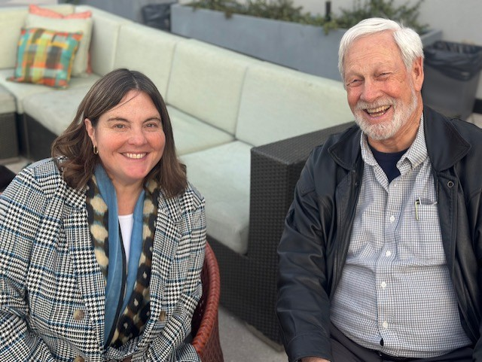
If you believe that higher education retirees are valuable assets to society, who reinvent, not retire from, life; positively impact their communities; and contribute to the greater good, then partner with us by supporting our mission

Slide 11
Eric Hockert (President-elect)
ehockert@alumni.umn.edu
AROHE.org

