Slide 1



CBC of civic society actors – practical
examples from PL-SK-CZ borders
Jable, 20 SEP 2016

Slide 2
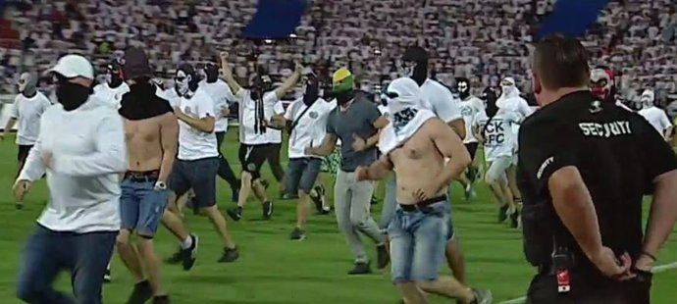
What is this?

Slide 3
When did you cross the borders last time?
Why do you cross borders?
When are you planning to do so next time and why?

Slide 4
My region

Slide 5
Examples of CBC by civic society
Loooong co-operation history on CZ-SK
Somewhat complicated CZ-PL relations
BUT
NGO CBC history longer than formalised CBC of public actors
Role of nationalities, local identities and EU funds

Slide 6
Inspiring projects
CBC Strategy of NGOs in Tesin/Cieszyn Silesia
26 NGOs from both parts of the Euroregion
The aim of the Strategy was to agree upon the basic principles and guidelines of the NGOs co-operation in Tesin Silesia.
Except for these general guidelines the more concrete project proposals have been identified.
The work was organized according to the following structure: all 26 participating NGOs created 3 working groups, aimed at: education/culture, leisure-time/culture and social services.
Each of the group held 5 meetings during spring 2009, which worked on the project core out, Strategy itself.

Slide 7
CBC Strategy of NGOs in Tesin/Cieszyn Silesia II (results)
for the first time since 1989 the cross-border co-operation of NGOs has been brought under one strategic umbrella in Tesin Silesia region
This resulted into significantly more cross-border co-operation projects prepared by the NGOs and also initiated new partnerships, hardly to appear without the project.
The project also helped to add the civic-society co-operation dimension into the CBC co-operation of the Euroregion itself.

Slide 8
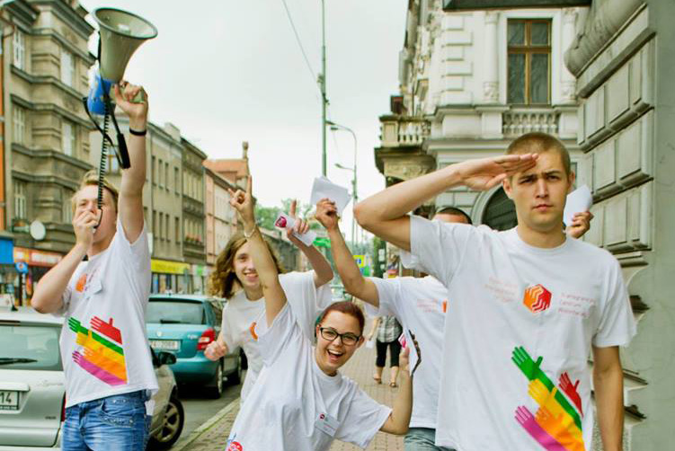
Cross-border Centre of Voluntary Activities
– epicentre of activities crossing the border

Slide 9
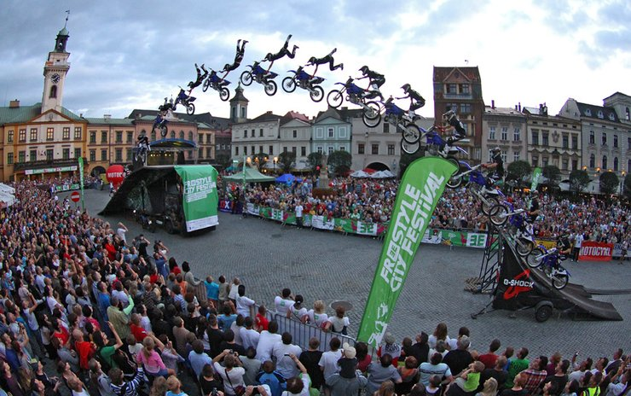
Freestyle City Festival

Slide 10
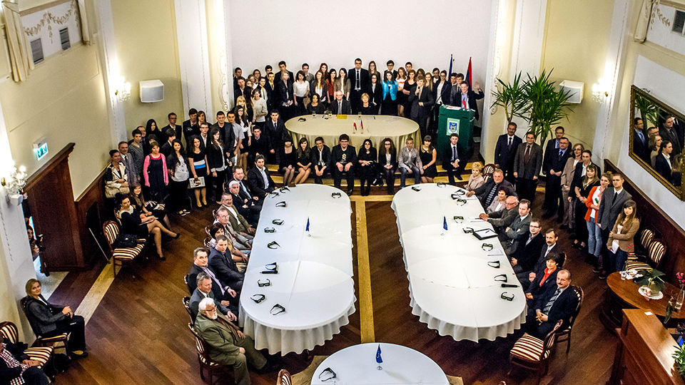
Cross-border Youth Parliament

Slide 11
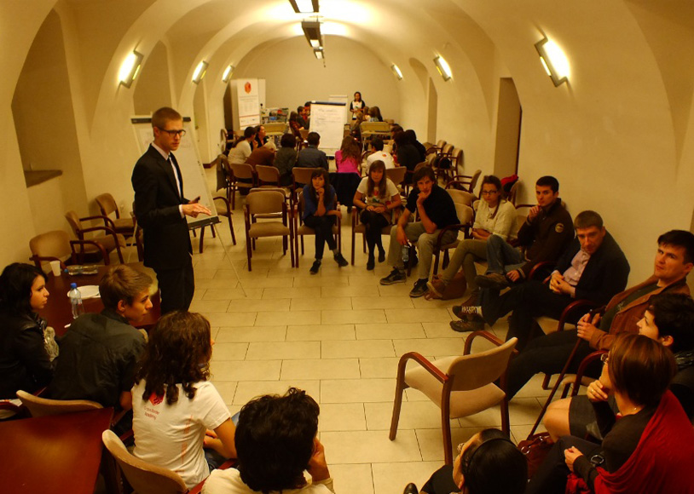
Cross Border Academy

Slide 12
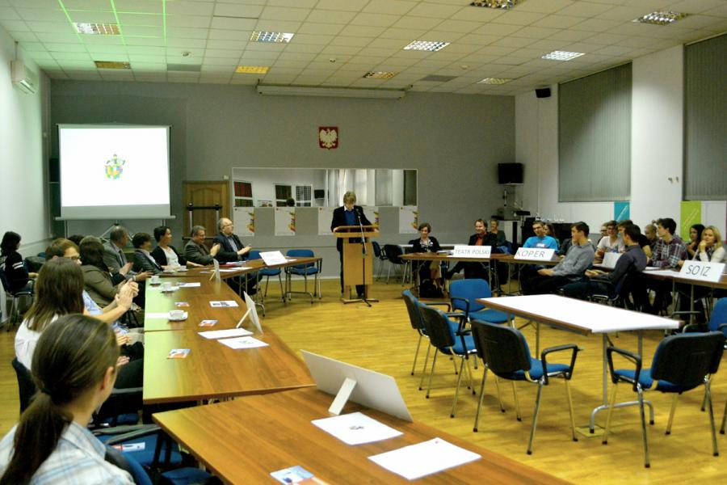
Round cultural table

Slide 13
Important!
All CBC activities are by nature something different and are harder to be implemented, compared to nationally-driven initiatives
We x them
Establishment of support mechanisms/expert bodies is inevitable (therefore we are establishing EuroInstitut PL-CZ-SK)

Slide 14
Thanks for your
attention!
Hynek Böhm, Ph.D.
hynek.bohm@tul.cz

