Slide 1


ASSOCIATIONS FOR THE
CROSS-BORDER COLLABORATION SUPPORTING eREGIONS DEVELOPMENT
Ana Nikolov, M.Sc.
AEBR coordinator for Balkans
CESCI Balkans director of planning
20th September 2016

Slide 2
CESCI Balkans
Established by CESCI (2019) in February 2015
To support CBC in the Balkans and to facilitate Serbia's EU accession process and integration.
CESCI Balkans provides expertise in:
  applied research on CB issues
  CB strategic planning and development
  of methodologies related to planning
  institution and project development
  mediation between the different levels of governance on CB issues,
  development of knowledge sharing tools, publication of brochures and methodologies,
  organization of professional events, trainings and conferences

Slide 3

AEBR Balkans
Established by Association of European Border Regions (1971) in May 2014
Joined forces with CESCI Balkans
in April 2015
AEBR role in the Balkans:
  Strengthen Euroregions in the Balkans;
  Initiation and Support of the new Euroregions;
  Capacity building of Balkan’s Euroregions to deal with CBC problems;
  Act as platform for exchanges of experience and information

Slide 4
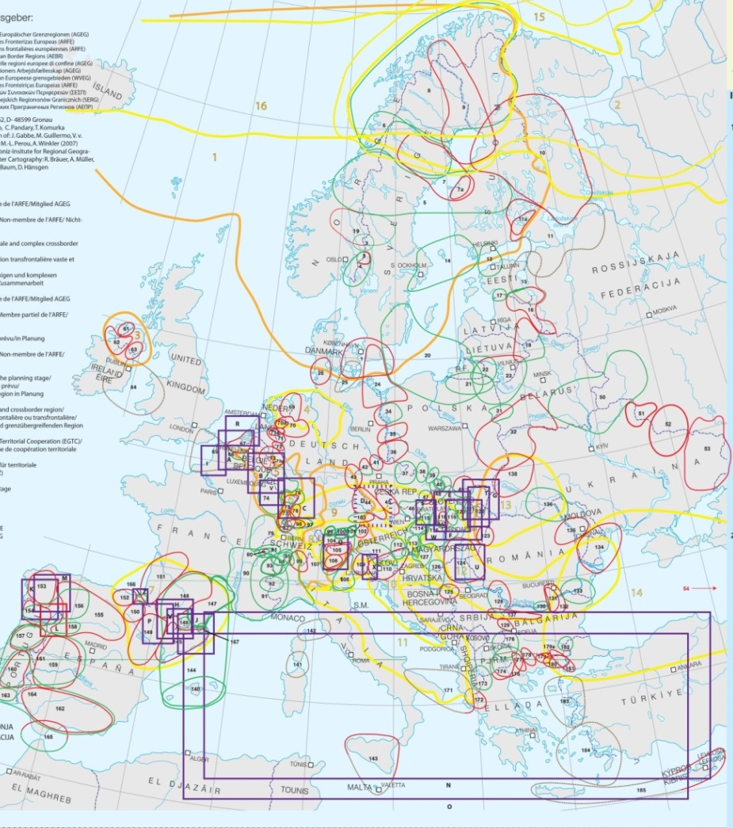
AEBR Balkans
  Improve public awareness
  of importance and value of CBC;
  Detect special problems, opportunities, responsibilities and activities of
  Balkan’s Euroregions;
  Initiate, support and coordinate cooperation between the
  Euroregions throughout Balkans;.
  Carry out the strategic plans and
  applied research on CB issues; and to
  Establish and coordinate the AEBR Network of Young Leaders for
  Cross-border Cooperation.

Slide 5

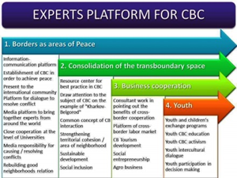
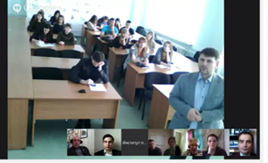
PROJECTS
VI, VII and VIII Youth Forum
(+videoconferences with Ukraine and Russia)
The Role of CBC Experts of Ukraine, Russia and European Union in Peace Building
School of international integration
and cross-border
cooperation 2015

Slide 6

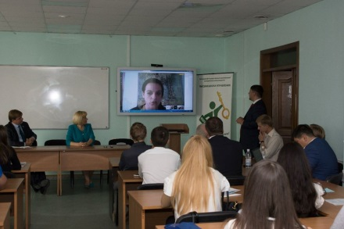
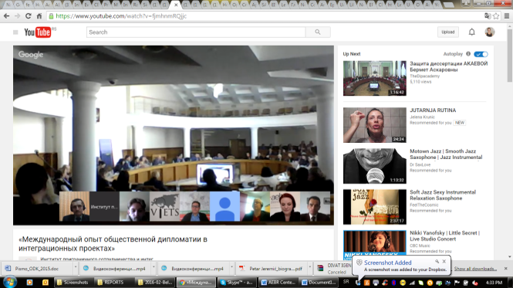
PROJECTS
Youth Video-Internet-Bridge
«Development of CBC between Youth
of European Border Regions»
Video conference “Urban Development in Border Areas”
Video conference “International experience of public diplomacy in integration projects”

Slide 7

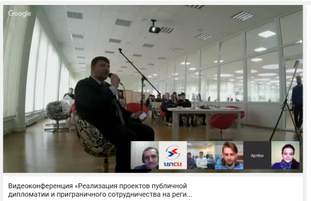

PROJECTS
Global Online Dialog 2016 - Youth Power for Positive Transformation
Video conference "Implementation of
public diplomacy projects and
CBC at the regional level"
Video Conference "Universities in the border areas, as actors of public diplomacy"

Slide 8

PROJECTS
Network of Young Leaders
for Cross-border Cooperation
How it works?
Youth Forum – seminars, workshops, discussion platforms, round tables
Online – meetings, seminars, workshops
Youth Charter for the Cross-border Cooperation
Supporting youngsters ideas and projects
Internship Programme

Slide 9
Thank you for your attention!
Ana Nikolov
ana.nikolov@cesci-net.eu
www.cesci-balkans.eu

