Slide 1

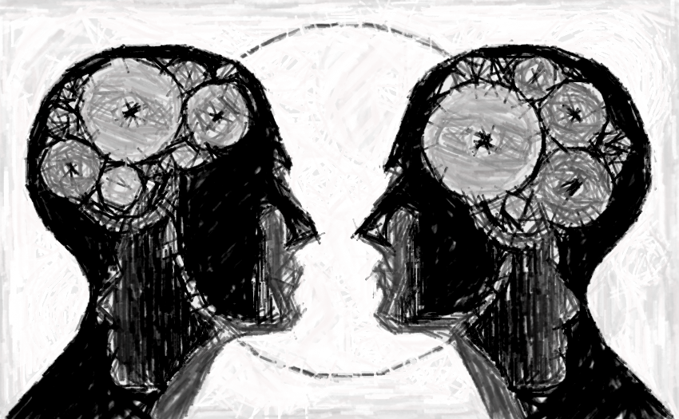
Does violence grow up?
Authors:
Kiara Ropoša
Nina Čontala
Mentor: mag. Jasna Vuradin Popović, prof. psih.

Slide 2
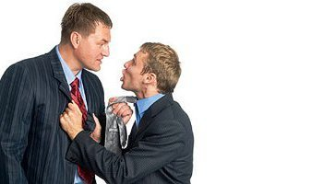
Agression and agressive behaviour
Physical or verbal behaviour
Each active attitude
Negatively expressed aggression: mugging, violence.
REASONS for aggressive behaviour

Slide 3
Hypothesis:
Punishment of elderly people in their youth was beating, nowadays youth‘s punishment is work and conversation.
Elderly people suffered mostly financial violence, nowadays youth face psychological violence.
Elderly people‘s opinion is that occasional physical violence upon women is normal and cannot be treated as violence.

Slide 4
What kind of violence have you experienced in the last year?

Slide 6
What in your own opinion is the attitude towards violence in Slovenian society?

Slide 7


Conclusion
Hypotheses:
  1st hypothesis
  2nd hypothesis
  3rd hypothesis

Slide 8
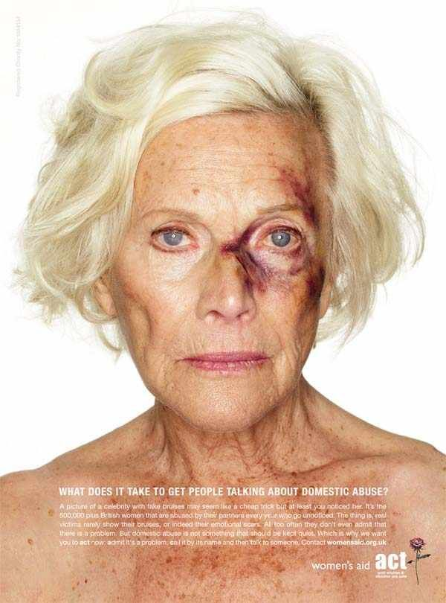
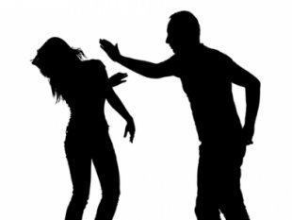
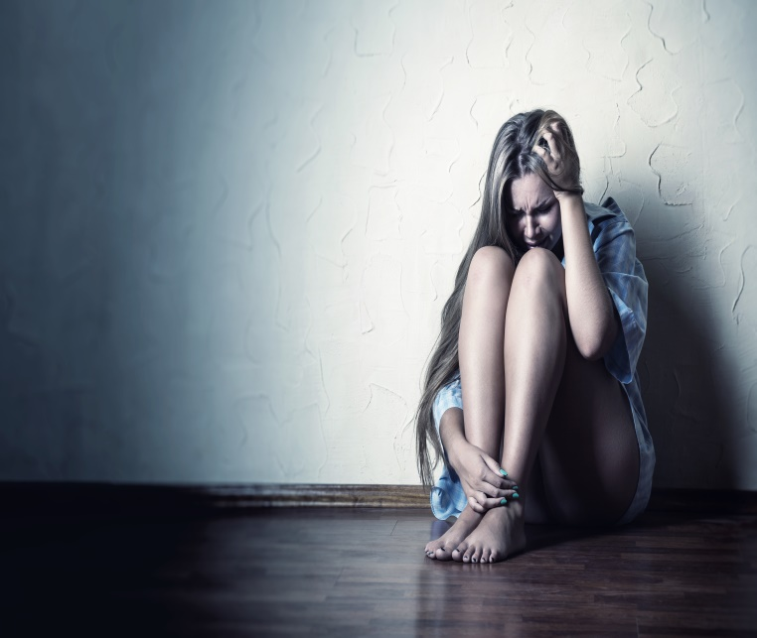
Message
Violence, unfortunately, does not grow up
Measures to reduce violence

Slide 9

Thank you for you attention!

