Slide 1

Activation of students' collaborative learning through LEGO robots
Students:
Taja Grifič Žvikart, tayazvikartgrific@gmail.com
Vladimir Obradović, metkes404@gmail.com
Tim Schaubach, tim.schaubach@gmail.com
Mentor:
Maja Čelan, Computer Science Teacher
maja.celan@guest.arnes.si
III. High School Maribor, Slovenia
6th eRegions Conference 2016:
Cross-border eSolutions & eServices Prototypes Development

Slide 2
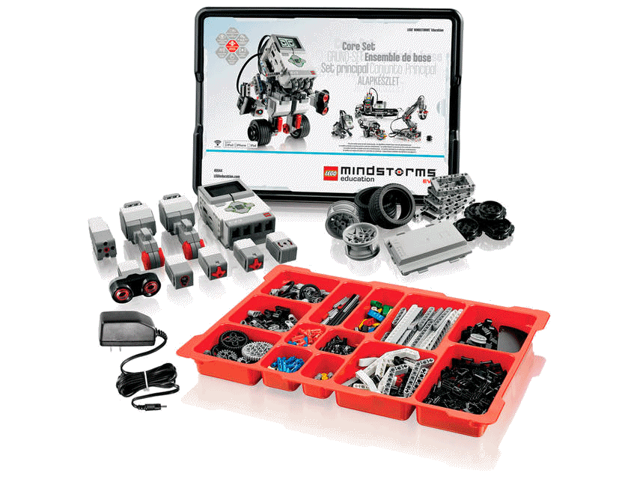
LEGO MINDSTORMS Education EV3 Core Set
INCREASE STUDENTS' INTEREST IN LEARNING HOW TO PROGRAMME

Slide 3
WAY OF TEACHING
INTERNAL DIFFERENTIATION IN THE CLASS
MAJORITY OF THE STUDENTS
SIX STUDENTS – VOLUNTEERS DIVIDED INTO TWO GROUPS
Traditional
Learning
Collaborative Learning
TRADITIONAL CURRICULUM
LEARN HOW TO PROGRAMME ROBOTS

Slide 4
