Slide 1


Slide 2
Panel Cross-border eCommerce of the SMEs in the eMunicipalities Without Borders
20. September

Slide 3





When you think about measurement you think about LOTRIČ Metrology.
calibrations
testing
conformity assessment
M&Q ACADEMY
metrology solutions
representations
Notes:
We are working in field of metrology - Calibration, testing, conformity assessment, metrology solutions and representations.
In all areas we invest in knowledge.

Slide 4


A family company
1923
laboratory
1991
establishment of the company
100+
employees
11.588 clients
in 36 countries
95%
of needs
58.162
metrology
checks
186
accredited
methods
21^{suppliers}
Notes:
LOTRIČ Metrology is a family company with 100+ employees.
We have been developing and offering metrology solutions for 25 years.
Our roots go back to the first laboratory in Kranj in 1923.
Why 100+: because the number is constantly growing.

Slide 5
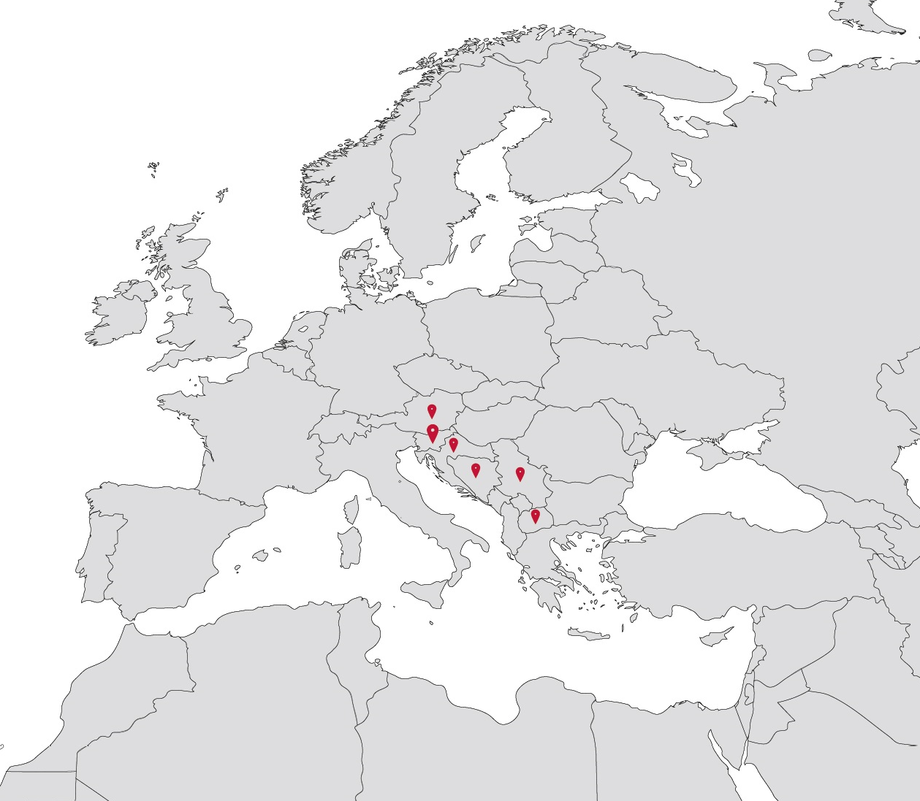
8 companies in the
LOTRIČ Metrology group
LOTRIČ Metrology, SLO
LOTRIČ Certificiranje, SLO
ISKRA LOTRIČ, SLO
LOTRIČ Messtechnik, AUT
LOTRIČ Mjeriteljstvo, CRO
LOTRIČ Metrologija, SRB
LOTRIČ Control, BiH
LOTRIČ Metrologija, MKD
Notes:
Within the group LOTRIČ Metrology we operates in 8 companies – in Slovenia, Austria, Croatia, Bosnia and Herzegovina, Serbia and Macedonia.
We are internationally acclaimed and orientated.

Slide 6
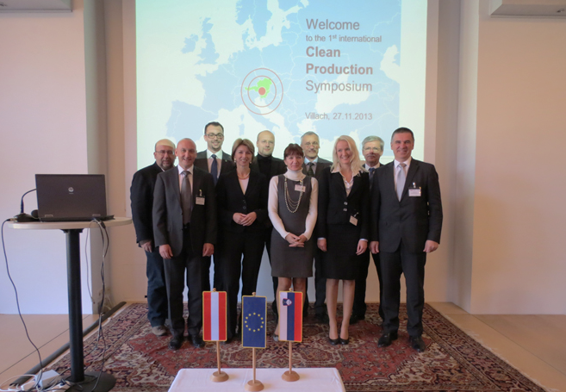
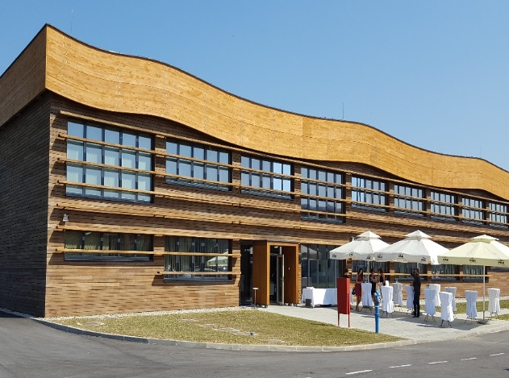
Clean production
(Interreg SI – AT)
Pannonian Wood
Competence Center
Partnering and networking among companies who are active in the field of clean production and are based in Slovenia and Carinthia.
Advanced laboratory equipment for the metrology laboratory:
EXACTUM, LiMS, laboratory equipment for testing wood products.
Notes:
Our references with crossbred cooperation and EU tenders.

Slide 7
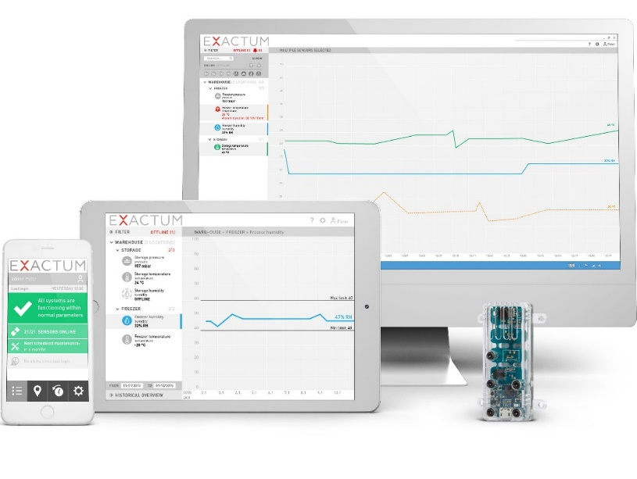
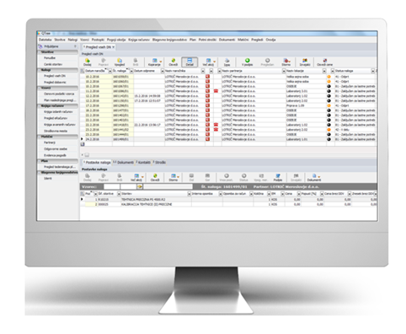
EXACTUM smart sensor hub
QTree Box
simplifying calibration
The innovative solution automatically protects your processes and products and helps you meet standards and requirements. With the EXACTUM system you decrease the chance of product loss and the risk of regulative non–conformity.
A custom-designed box containing all the tools needed to start your calibration. You will get exactly what you need, including reference etalons, software, training, and instructions with standardised procedures of calibration of various measures.
Notes:
Our references with crossbred cooperation and EU tenders.

Slide 8

Synergy between science and technology
Cross-boarder Centre of excellence
Cooperation between science and business, will enable knowledge transfer and technologies. Therefore, innovative ideas and products will help companies easier market entry and competitiveness.

