Slide 1

OBMOČNA OBRTNO-PODJETNIŠKA ZBORNICA ŠKOFJA LOKA
REGIONAL CHAMBER OF CRAFT AND SMALL BUSINESS ŠKOFJA LOKA
Jože Misson, president

Slide 2
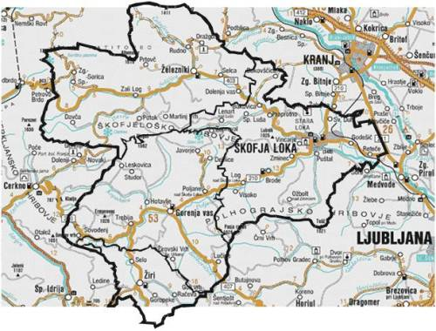
Presentation
Established: 16 April 1976 as Association of Independent Craftsmen
Since 1.1.2008 on, it operates under the name REGIONAL CHAMBER OF CRAFT AND SMALL BUSINESS ŠKOFJA LOKA
Objective: to achieve better operating conditions with joint powers
Independent, professional, nonparty, business organization that unites craftsmen and entrepreneurs
Covers municipalities:
Gorenja vas-Poljane, Škofja Loka,
Železniki and Žiri

Slide 3
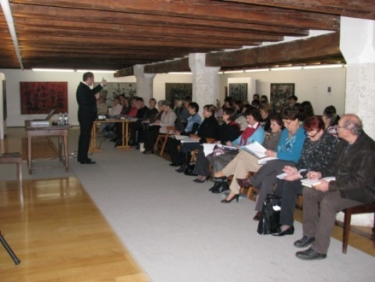
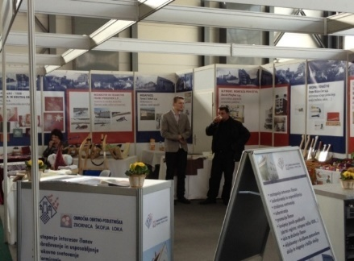
Tasks (1)
helps craftsmen and entrepreneurs that seek for assistance and information in a peer organization due to complex and often incomprehensible legislation
represents the interests of its members;
forms initiatives, remarks and demands for improving the conditions for developing crafts and small business;
organizes various educations and trainings;
informs its members about novelties in various areas;
takes care of members’ promotion;

Slide 4
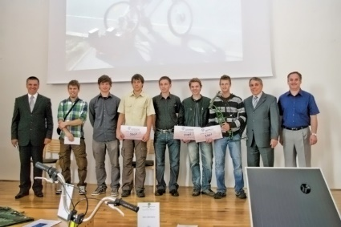
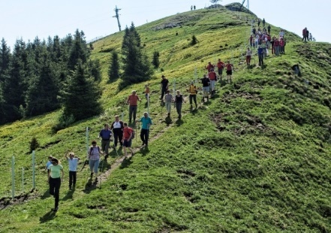
Tasks (2)
provides professional counselling and professional help to its members;
represents employers’ interests and cooperates with employers’ association;
implements various public authorities (craft register, e-VEM entry point,..);
cooperates actively with municipalities and other organizations at the local level and state institutions;
takes care of members socializing.

Slide 5
Membership and
Sections’ Operation
On 31.12.2015 the Chamber had 741 voluntary members.
Members group in 13 professional sections, which are the basis of chamber’s operation.
Important sections are:

Slide 6
Membership and
Sections’ Operation
Sections based on the interests of members:
Sports Section:
takes care of sports activities of members, their family members and employed workers
Retired Craftsmen Section:
joint members who terminated performing their activities as craftsmen and entrepreneurs due to retirement.

Slide 7
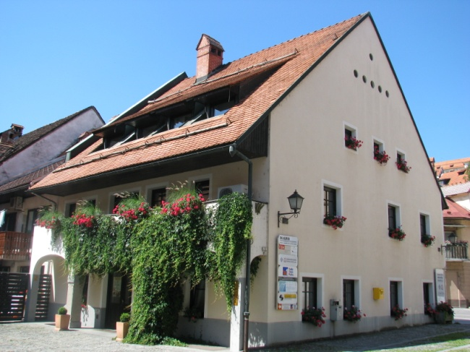
OBMOČNA OBRTNO-PODJETNIŠKA ZBORNICA ŠKOFJA LOKA
Regional Chamber of Craft and Small Business Škofja Loka
Spodnji trg 2, 4220 Škofja Loka, Slovenia
Tel: +386 (4) 50 60 200
E-mail: ooz.sk.loka@siol.net
URL: www.ooz-skofjaloka.si

