Slide 1
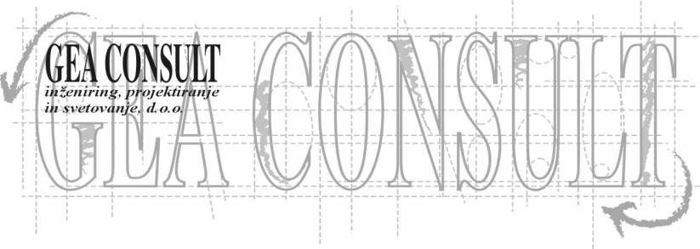
GEA CONSULT d.o.o.
Engineering, design and consulting
established 1996 (1994)
employee 6 – 12
income 0,5 – 1,0 mio EUR

Slide 2
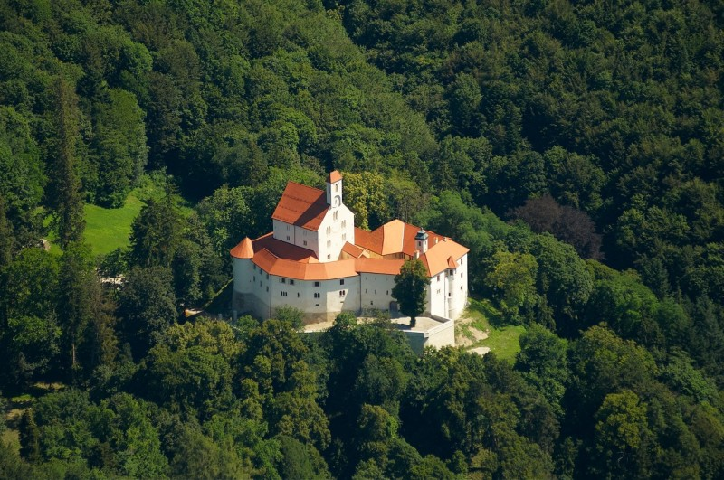

Slide 3
DESIGN
- reconstructions, restoration (castles – Jable, Turjak, Snežnik, Rajhenburg, Pišece, Radovljica, Strmol, …)
- business facilities (Radovljica športni park)
- facilities for education (MIC Škofja Loka)
- construction of dwellings (private houses)
traffic calming (Reteče, …)
…

Slide 4
A SUPERVISOR IN THE CONSTRUCTION
- reconstructions, restoration (castles, National galery, …
- business facilities (Panplast Logatec, Viro…)
- facilities for education (ZRC SAZU Laboratories Ig)
- construction of dwellings (Stanovanjski sklad RS – 104 flats, Ljubljana Brdo)

