Slide 1

Inter-Municipality Initiative: Cross-border eCollaboration in the eRegion
Networks for Complex Problems Solving
Dr. Jože Gričar, Professor Emeritus, University of Maribor, Slovenia
Joze.Gricar@UM.si
eLearning tools and partnerships used by Professor Emeriti
to facilitate teaching/learning
among older adults and their families: Some illustrative examples
Professors Emeriti Network Zoom Meeting on February 16, 2022

Slide 2
Problem
A problem is a difference between the existing and the desired state.
The problem complexity is defined by
the number of entities which have to be considered
the number of interactions between them
their interdependencies.
The problem is always tied to the person; there is no problem if she/he is satisfied with the current state.
The defined problem is already half solved.

Slide 3
What is the problem?
Networks and associations dealing with the issues in active aging do not collaborate enough in order to learn from each other, share experience, and engage in possible joint actions.
To a greater extent, we could reap the benefits of using high-speed Internet.
Sustainable lifelong learning presupposes intergenerational and interdisciplinary cooperation through the use of the eServices.

Slide 4
Networks - advantages
Activating individuals
Accelerating collaboration
Abolishing borders of all types
Stimulating innovation
Opening-up interdisciplinary cooperation in problem solving
Enabling linking with similar networks
No new investment required
Operating practically at no cost

Slide 5
Networks - the requirements
Openness to eCollaboration
Willingness to openly provide ideas and share best practices
Readiness to consider others’ opinion
Expectation to exchange messages in a less hierarchy environment
Need time to be established and become operational

Slide 6
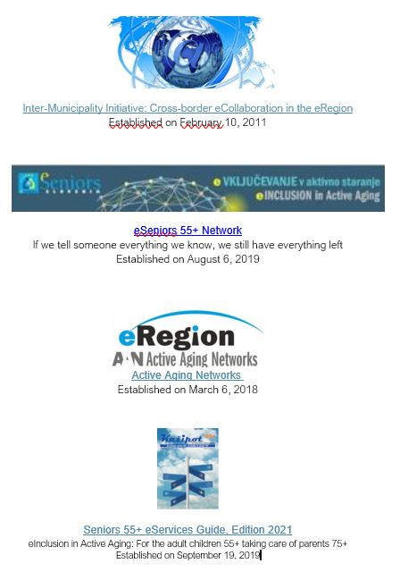

Slide 7
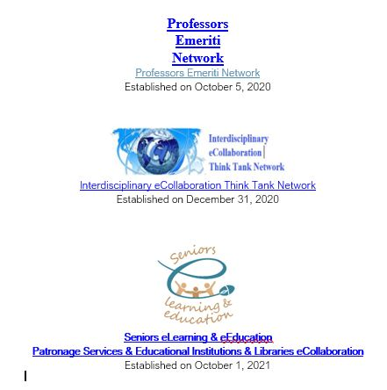

Slide 8
Invitation
Considering the problem defined, you may like to join one of the existing networks or establish your own network based on using eTechnologies.
Cross-border eCollaboration of the networks in the eRegion of the neighbouring countries is recommended.

