Slide 1
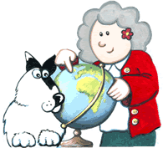
Learn with Grandma
Valerie Wood-Gaiger MBE
valwoodgaiger@aol.com
+44 1550 721884

Slide 2
Learn with Grandma
Learn with Grandma a not for profit NGO registered in Wales reg no. 8259039.
There are now 43 Learn with Grandma Groups on Facebook!
From Canada to Australia; Ukraine to Uganda. – 21 groups in Africa.
Including Latvia of course! How many of you use Facebook?

Slide 3
Intergenerational Learning
Sharing skills and knowledge across the generations.
Young people are better at computers
Technology bridge to reunite generations

Slide 4
Uganda
In 2014 –- I was a speaker at e-learning Africa Conference.
I suggested they hold an Annual UUConference - 300 head-teachers attended the first.
2018 it is now a 2 day conference supported by the Ministry of Education & 2000 head-teachers attended.
Notes:
British Council showed me a lovely book written in Bugandon & English – I asked would they print in the other 6 languages – No! Cost is too great – got me thinking – there has to be a cheaper way! E-Books??

Slide 5
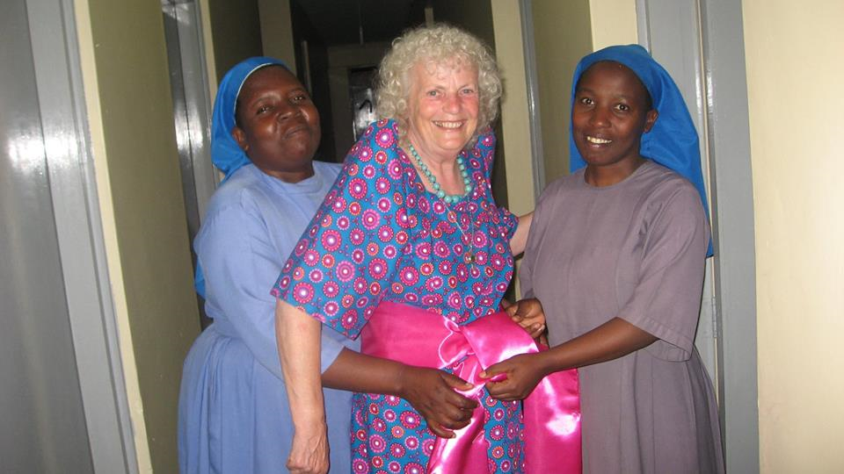
Uganda
Notes:
I stayed with the Nuns – the headmistress gave me that lovely dress!
Was still thinking of ways to create e-books but I wanted to include audio – so that people could hear the language & film to see where the action took place.
Was told it’s not done – but I thought it could be done! We just had to find a way!

Slide 6
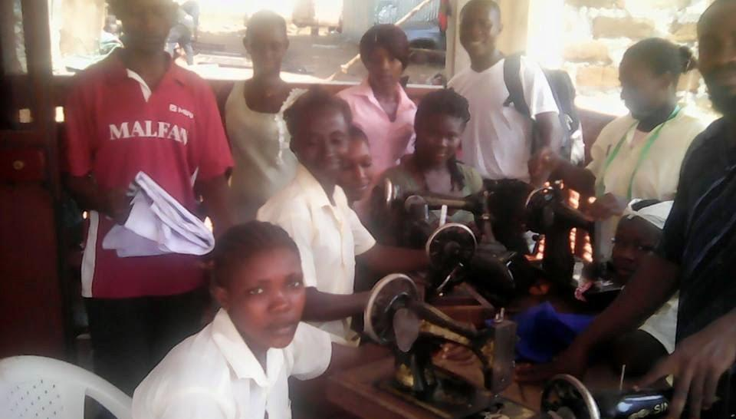
Sierra Leone Sewing Workshops

Slide 7
Sierra Leone Sewing Workshops
Girls rescued from the streets
Girls taught to sew by ladies of church congregation
Sanitary towels, orphan clothing, maternity clothes
Benefits the community

Slide 8
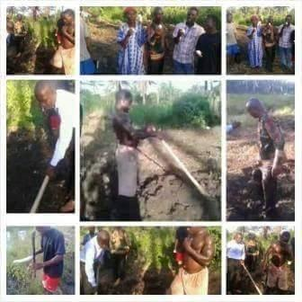
Sierra Leone - Horticultural Project

Slide 9
Sierra Leone
Horticultural Project
Land donated
Land cleared
Land planted
Now provides food for community

Slide 10
Criteria
Achievable
Affordable
Sustainable
Inter-generational
Fun

Slide 11
How to inspire people in all these diverse countries ?
A project that would work in every country
use the resources, ingenuity, talent, skills
bring the generations together
use technology
Is needed
inspire people to get involved

Slide 12
How to inspire people in all these diverse countries ?
I was seeking a project that would work in every country.
Decided that creating e-books – as an intergenerational learning project – would also help preserve the wonderful Legends that exist in every country.

Slide 13
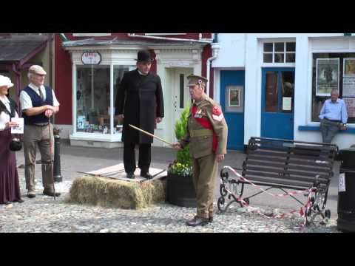
Llandovery Street Story
https://youtu.be/br52io7sfa8
Notes:
Here is an illustration of how a community came together to tell a story. The youngest ‘actor’ is a babe in arms; the oldest Dai is over 80! https://youtu.be/br52io7sfa8

Slide 14
E-books v ‘Proper’ Books
An e-book is a proper book!
They can be read on any device from a mobile phone to a large screen and can offer more -Text, Audio & Visual.
E-books need not go out of print – they can be re-mastered & be available for everyone; everywhere – forever!
Better for the environment.
No transport cost or trees cut down.

Slide 15
Great Educational Opportunities
Learn with Grandma’s main aim is to reunite the generations:
Many older people love to teach their skills to younger people.
Many younger people love to show older people the internet
Develops IT skills & Life Skills

Slide 16
E-books v ‘Proper’ Books
Creating e-books is a way of bringing the generations together.
Interesting projects encourage greater respect & understanding between the generations
– and are fun!

Slide 17
Methodology
As we create the e-books we create a methodology for teachers & community leaders.

Slide 18
Local Talent, Skills & Culture
Identify people who have the skills and talents needed.
Writers, illustrators, actors, photographers, narrators, music makers, etc.
costumes, set design, props.
A project for the whole community!

Slide 19
Funding
You don't need much money.
Only mobile phones needed.
You could apply for grants, but you can also raise money the old fashioned way – ask for donations, put the hat round at play performances etc.
Money is needed to put the books online.
Dedicated website for all books - Grandma's Digital Library

Slide 20

Sustainability
Grandma's Digital Library
Permanent free resource
Accessible to everybody
All over the world

Slide 21
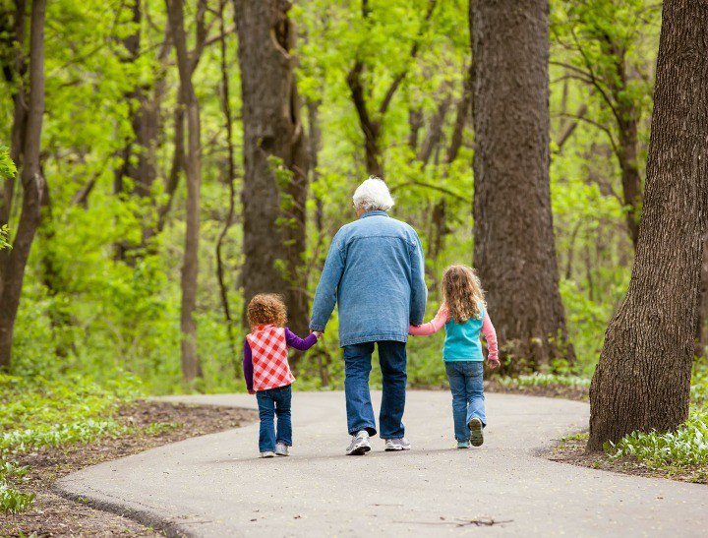
Grandparents who care for their grandchildren live up to five years longer!
Working & having fun across the generations = a longer; happier lives! http://dx.doi.org/10.1016/j.evolhumbehav.2016.11.010

Slide 22
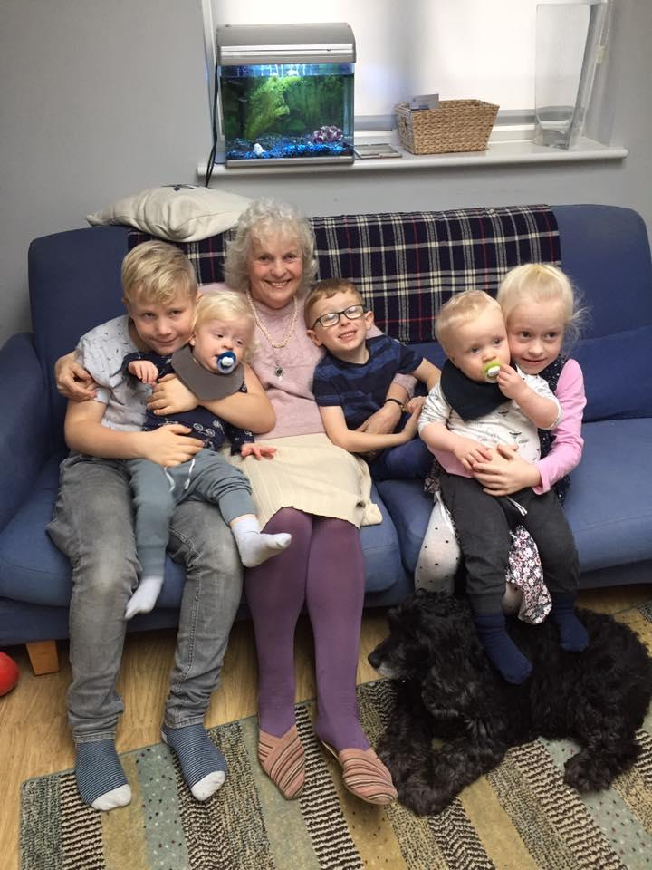
Thank you!
With my 5 great grandchildren
& my little dog Lily.
Two more have arrived since that phot was taken!

Slide 23
Learn with Grandma
a not for profit NGO registered in Wales reg no. 8259039
Valerie Wood-Gaiger MBE
valwoodgaiger@aol.com
+44 1550 721884

