Slide 1

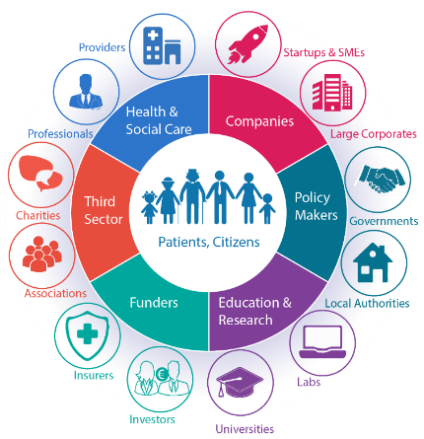





ECHAlliance – overview and projects in active&healthy ageing
Gregor Cuzak,
International Ecosystem Coordinator
gregor@echalliance.com
www.echalliance.com / info@echalliance.com

Slide 2














About ECHAlliance
Member Organisation (650+ organisations - Join Us)
Companies, policy-makers, researchers, health & social care providers, patients, insurances…
who
16,500+ experts / professionals
Not for Profit Organisation
Registered in Ireland and in the UK (Community Interest Company CIC)
Growing reach across 78 Countries and 4.4 billion people Europe, USA, Canada, China & the Commonwealth
where
International Network of Ecosystems
(100+ ecosystem gatherings a year)
what
Connecting & joining the dots
Communication
/ networking
Membership Support
International events
/ groups / workshops
H2020 projects, tenders & expert services

Slide 3

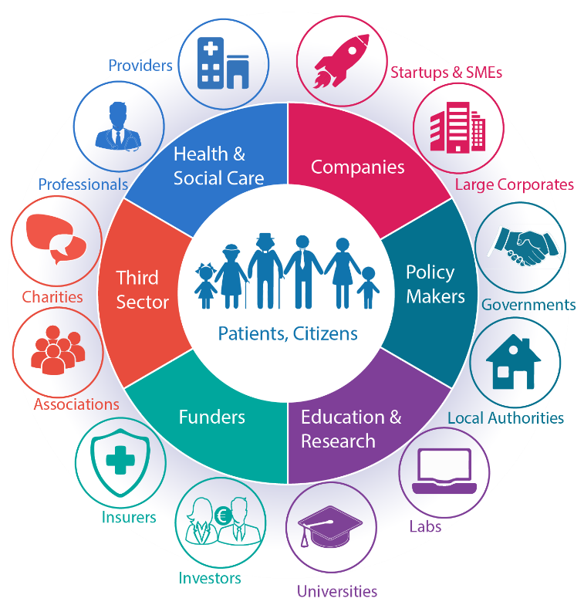
Permanent Ecosystems: basic principles
  Based on a geographic area
  Multi-sector stakeholders gathering
  Accessible to all (no barriers)
  Permanent, with regular gatherings
  Light governance via working group
  Shared strategy & action plan
  Lead with a need
  Member of an International network
  Patients / Citizens at the centre

Slide 4
Ecosystem Benefits
Meet
Learn
Collaborate
Showcase
Opportunities
Knowledge sharing
Global
reach
Build trust

Slide 5
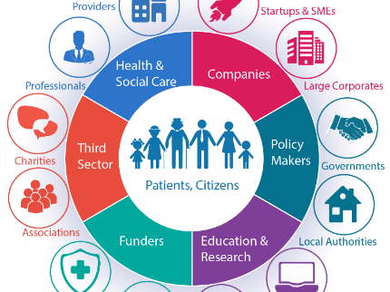
ECOSYSTEMS………………..
Break down silos,
transform healthcare delivery
and create economic growth

Slide 6























Members of the International Network of Ecosystems
100+ quarterly gatherings per year
Existing Ecosystems
  Malta
  Netherlands - Friesland
  Northern Ireland
  Portugal
  Republic of Ireland
  Serbia
  Scotland
  Highlands & Islands (Scotland)
  Slovenia
  Spain – Valencia
  Spain - Galicia
  Spain – Catalonia
  USA - New York
  Wales
Launching soon
Belgium – Brussels
Belgium - Flanders
Canada – Ontario
Czech Republic
Denmark – South
England – Manchester
England - North West Coast
England – London
England - Yorkshire & Humber
Estonia
Finland – Oulu
France – Nice PACA
Germany – Rheinland
Greece - Athens
Bretagne France
Sweden
Exploring Prospects
Africa
Australia
Canada
Finland
Germany
Norway
Romania
Spain
Sweden
UK

Slide 7

Ecosystems Priorities Matrix
Supports and encourages inter-ecosystem collaboration, greater engagement & H2020 Consortiums
Priority Area \ Ecosystem | Brussels (BE) | Catalonia | Estonia | Friesland (NL) | Galicia (SP) | Greece | Ireland | Manchester (UK) | North West Coast (UK) | Northern Ireland | Oulu (FI) | Portugal | Scotland | Highland & Islands (Sco) | Serbia | Slovenia | Southern Denmark | Valencia (SP) | Yorkshire & Humber (UK) | Wales | Bretagne, (FR) | Flanders (BE)
Electronic Health Records | S | S |  |  | S | N | P |  |  | P | P |  |  |  | P | S |  | S | P | P |  | S
Tele Health / mHealth |  | S | S |  |  |  |  |  |  | P | P |  | P |  | P |  | S |  |  | P | S | S
Mental Health |  | S |  | S |  |  |  | N |  | P |  |  |  |  | N |  | P | N |  | P |  | N
Dementia |  |  |  | S | N |  |  |  |  |  |  |  |  |  |  |  |  |  |  |  |  | S
Preventive Care |  |  | S | S |  | P |  |  |  |  |  |  |  |  | P |  |  |  |  |  | P | N
Active Healthy Ageing (AHA) |  | N |  | S | P | P |  | S |  |  | S | P |  |  | N | N | S |  |  | S | S | S
Integrated Care | P |  |  |  |  | N | P |  |  |  | S | P | P |  |  |  | P |  |  | P | P | P
Medicines Optimisation |  |  |  |  | N |  | P |  | P | P |  |  | P |  |  |  | N
Analytics and BI |  |  |  | N | N |  | P | S |  |  | P |  |  |  | P |  | P |  |  | P | S
Artificial Intelligence |  |  |  |  | N |  |  |  |  |  |  |  |  |  | P |  |  |  |  |  | P | P
Home Care |  |  |  | S | S |  | N |  |  | P | P |  |  |  | N |  |  |  |  |  |  | S
Health Tourism |  |  |  |  | S | P |  |  |  |  |  |  |  |  | S |  |  | S
Interoperability | S | S |  |  | S | N | N | N |  |  |  |  |  |  |  | S | S |  | P |  | S | N
Patient Engagement |  | N | S | P | S |  | N |  |  |  | N | P |  |  | S | N | P |  |  |  | N | N
Funding, Financing, Support | N |  |  | N | N | N |  | N | P |  |  |  |  |  | N | N |  |  |  | N | N | P
Scaling | N |  |  | N |  | P |  |  | P |  |  |  |  |  |  |  |  |  |  | N |  | N
Access to healthcare | P |  |  |  |  |  |  |  |  |  |  |  |  |  | P
Bioinformatics |  |  |  |  |  |  |  | S |  |  |  |  |  |  |  |  |  |  |  |  |  | S
Smart Healthy Cities |  |  |  |  |  |  |  | S
Image guided Therapy |  |  |  |  |  |  |  |  |  |  |  |  |  |  |  |  |  |  |  |  | S | S
Data sharing ethics & regulation |  |  |  |  |  |  |  |  |  |  |  |  |  |  |  |  |  |  |  |  | N | N
Rural health |  |  |  |  |  |  |  |  |  |  |  |  |  |  | P
Smart business modelling |  |  |  |  |  |  |  |  |  |  |  |  |  |  |  |  |  |  |  |  |  | S
S = Strength
N = Need
P = Priority (not defined)
A work in progress

Slide 8




ECHAlliance – Projects for 55+
WE4AHA
supports the definition and execution of an Innovation to Market (I2M) plan, further development of the Blueprint to drive the policy vision on digital innovation, and the consolidation of EIP on AHA Action Groups and Reference Sites
Active & Healthy Aging (SEED)
supporting the Recognition of the Silver Economy in Europe: Rewarding innovative solutions that demonstrate a significant impact on the quality of life of the ageing population.
EDEN – Embracing Dementia
Focusing on adult education, the ECHAlliance and its partners are developing a holistic approach including both professional caregivers, relatives and civil society and their interaction when handling dementia. The project aims at facilitating a better quality of life for the demented and relatives alike.
Smartwork – Smart Age-friendly Living and Working Environment
Work ability modelling capturing the attitudes and abilities of the ageing worker and enabling decision support for personalized interventions for maintenance/improvement of the work ability. The SmartWork services and modules also empower the employer with AI decision support tools for efficient task completion and work team optimization through flexible work practices.

Slide 9




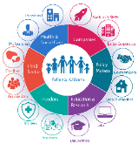

The Global Network of Digital Health Alliances
\
Connecting 78 Countries and 4.4 billion people
Canadian Integrated Health Alliance
China Consortium Health Alliance
Contact us info@echaliance.com

Slide 10




ECHAlliance Membership: Recent New Members
JOIN US NOW!
www.echalliance.com
under ‘Members

Slide 11
ECHAlliance – overview and projects in active&healthy ageing
Gregor Cuzak,
International Ecosystem Coordinator
gregor@echalliance.com
www.echalliance.com / info@echalliance.com

