Slide 1

Empower seniors to be e-included : they will become active and creative citizens and change society!
eServices for Seniors (55+)
Skofja Loka Slovenia, April 2019

Slide 2

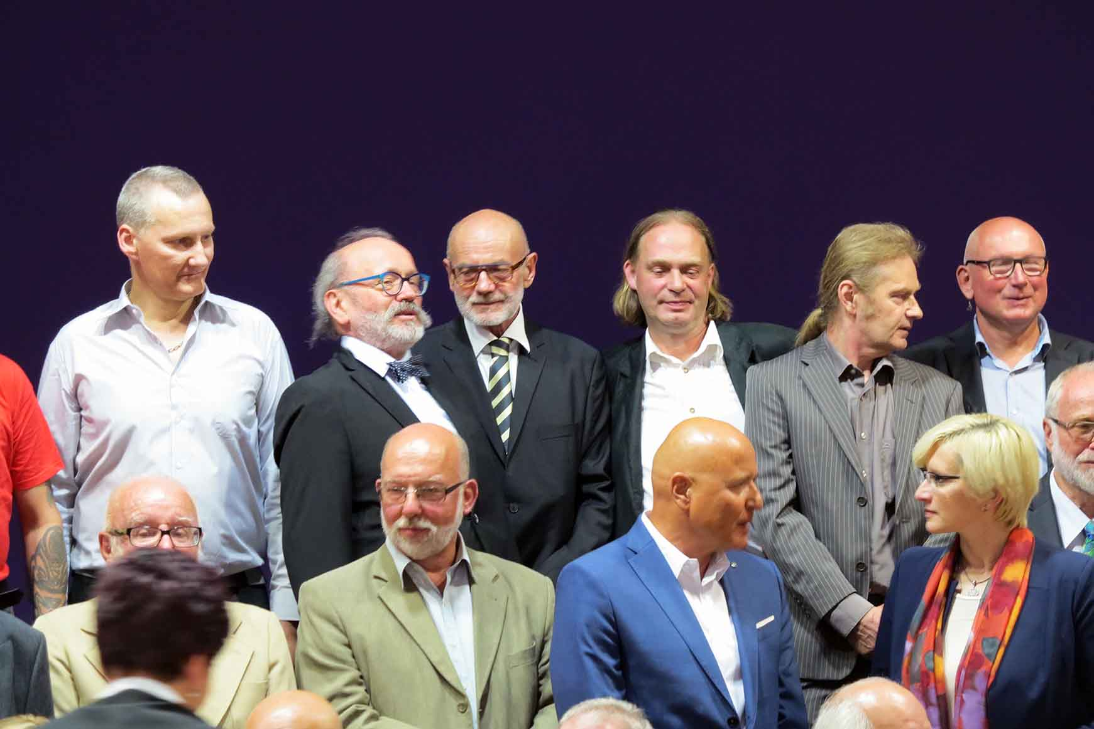
Empowering seniors to be e-included
Empowerment means giving the tools (and web communication tools are the best for that) to :
impose one’s will in the context
of a social relationship and decision taking
fight against discrimination due to age
GIVE SENIORS a PURPOSE in LIFE
and a PLACE in SOCIETY
Retirement no longer means inactivity
the market activity (previous paid job) becomes a free activity
seniors get involved in social and civic activities
they often fill the gaps of the state or the private market with valuable know-how, experience and useful networks

Slide 3


Creative skills : active and healthy ageing
Acquiring digital skills will open doors :
- better communication with other generations or with other people through social networks/ forums
- more opportunities of daily activities involving cognitive and physical stimulation -> impact on health
- training for new competences or even be coached to find some new job or paid activity ( as e-entrepreneurship / offering products or services on the web)
Every senior/ retired person is concerned an d Eseniors helps to
acquire Internet CULTURE
demystify/gain control over “these” machines
learn how the Internet can make life simpler

Slide 4

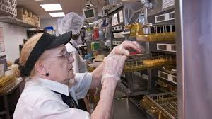
Seniors are also citizens….
Talking about seniors as citizens is NEW
it implies to value their place and value in society
It is possible now because retired people spent at least
20 years of their life as quite healthy
They represent 30% of the population
And have stable financial income (even if not always high)
As citizens they can represent their generation in the co-construction of societal changes following important demographic and technological changes which both impact our society and daily life
Of course there are barriers
- the way some young people consider elderly
- the fact that some people are not used to discuss social issues with others

Slide 5


Societal changes and challenges
Several issues:
people live much longer -> more seniors in our societies
retired people have more free time
seniors need to be re-engaged in social and economic life
national budgets (social…) under pressure : no way to finance some existing (or new) social services
Solution : new way of practicing democracy: engaging citizens much more actively and directly in finding new ways of solving problems in the communities
It will not be the same for all citizens : it will fit best for the ones who have had interesting lives / know many things – and like the idea that even if you are a senior/retired, you can carry out important missions in society and , at the same time, enrich your life

Slide 6

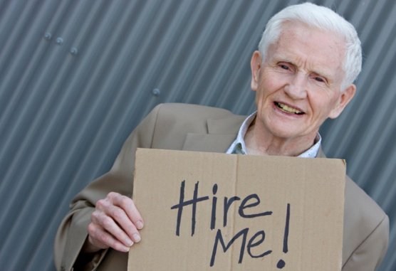
Jobs for seniors versus volunteering
Volunteering is the most common activity
for social commitment
But seniors are often looking for a financial complement to their pensions
Here are some ideas of little jobs for which you can put ads on Internet
foster grandparents (coaching children with school difficulties)
seniors companions : home care giving/lodging a Alzheimer/Parlinson patient for several days as a rest solution for carers
subletting a room in a flat for a student (+ intergenerational communication)
coaching young people to assert one's personality or find one's way
Selling services or products online
In most EU countries, senior volunteers get no compensation but this might change in the next years
In US, seniors often do receive scholarships or reimbursements for expenses

Slide 7


Seniors and
Information & Communication Technologies
E-SENIORS
- LIFE BEGINS AT 50 -
  The objectives of the association are to:
  Reduce the digital divide between the different generations
  Overcome seniors’ isolation and social exclusion
  Facilitate access to training and information
This way E-Seniors aims at increasing solidarity in the digital society and at spreading the Internet culture

Slide 8

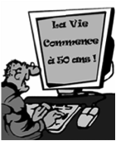
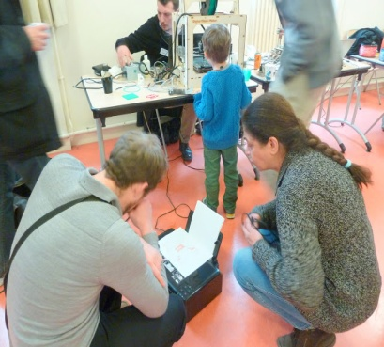

E-SENIORS’ Activities
ICT trainings
for Parisian seniors
Local Projects
designed for all ages and encouraging solidarity
European Projects
sharing good practices in digital innovation throughout the EU

Slide 9






E-SENIORS
LIFE BEGINS AT 50
Thank you for your attention
For more information :
E-SENIORS www.e-seniors.asso.fr
www.eseniors.eu
Monique Epstein epstein@free.fr
Thank you for your attention
For more information :
E-SENIORS
www.e-seniors.asso.fr
Monique Epstein mepstein@eseniors.eu
24

